Slide 1
Getting Git
by Daniel Cox
Notes:
hello
I’m daniel cox, a software engineer on i2ps, and this is Getting Git.
I asked to give a talk on git because I believe it to be brilliant but misunderstood software with a high-learning curve, and I think every developer would benefit from a deeper understanding of it

Slide 2
Getting Git
by Daniel Cox
(who is enormously grateful to Scott Chacon for half of these slides)
Notes:
half my slides come from a presentation of Scott Chacon’s,
which I’ll mention again at the end
since the talk ended up being shorter than I expected, please feel free to interrupt me with questions

Slide 3
THE MASTER PLAN
What is Git?
Understanding Git
The Basics
The Git Object Database
History Inspection
Branching Workflows
Collaboration
Advanced Stuff
Troubleshooting
Review
Resources
Questions
Notes:
here is the master plan

Slide 4
THE MASTER PLAN
What is Git?
Understanding Git
The Basics
The Git Object Database
History Inspection
Branching Workflows
Collaboration
Advanced Stuff
Troubleshooting
Review
Resources
Questions
3 minutes
15 hours
2 minutes
3 minutes
20 minutes
Notes:
and here is the approximate breakdown.
the talk is mostly meant for those of you who already use git but don’t love it yet,
though I do have a few slides on what git is

Slide 5
What is Git?
Git is a Version Control System
Versioning
Collaboration
Other things Git is:
A very simple content tracker
A key/value object database with a VCS front-end
A toolkit
Notes:
git, first, is a version control system. it was designed to solve two major problems
versioning - you need to keep history of your content so you can e.g., go back… or branch off to try new things… remember what you've done… try to figure out what someone else has done...
collaboration - you need to work together with other people on a project without emailing files back and forth or overwriting each other's changes
other things git is: a very simple content tracker, a key/value object database with a vcs front-end, and a toolkit

Slide 6
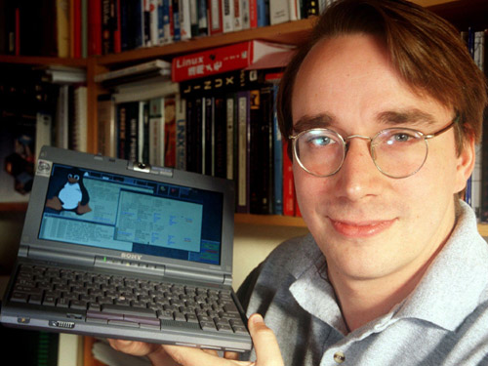
What is Git?
"I'm an egotistical b[------], and I name all my projects after myself. First 'Linux', now 'git'.”
-- Linus Torvalds
Notes:
it’s also a creation of linus torvalds, to serve the needs of the linux kernel

Slide 7
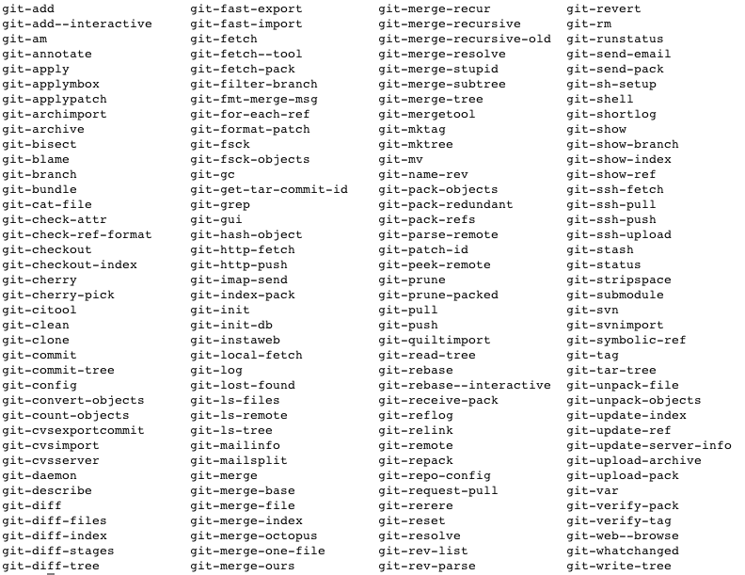
Notes:
Git is a toolkit of about 152 commands…

Slide 8
Notes:
most of which are not useful to humans, and exist mostly to be run by other commands and scripts.

Slide 9
the “plumbing”
Notes:
These are referred to as “the plumbing commands”, and we’ll only get into a couple of these

Slide 11
Notes:
However, there are about 40 commands which human users are expected to need frequently at the command line, to perform most of the useful features git provides for your daily work.

Slide 12
the “porcelain”
Notes:
These are “the porcelain commands”.

Slide 13
Notes:
We’ll cover about half of these, and touch briefly on more.

Slide 14
What is Git?
Something Git is not: Subversion
Much faster for a slightly larger disk footprint
(stores snapshots instead of deltas)
Can do a bunch of stuff without a network connection
Cheap branching and merging
No .svn directory clutter
And quite a bit more, since Git was not designed to be the latest evolution of rcs -> cvs -> svn -> …
Notes:
here’s something git is not - it’s not subversion
git is much faster, you can work on an airplane, branching isn’t something you need to have a meeting about, git drops in one hidden directory
and much much more!
Git uses a lot of the same vocabulary as Subversion, but a different dictionary. The words have quite different meanings.
(checkout, commit, branch...etc. - they mean completely different things in git than they do in subversion)

Slide 15
What is Git?
What Git is on your hard drive.
$> mkdir foobar
$> cd foobar
$> git init
$> tree –a .git
Notes:
Git hides out of your way until you need it, in a hidden directory in the root of your project folder: .git
here we make an empty foobar directory, go into it, and run git init to make it a repository. now we’ll look inside the new .git directory

Slide 16
What is Git?
$> tree –a .git
.git
├── HEAD
├── config
├── description
├── hooks
│ ├── applypatch-msg.sample
│ ├── commit-msg.sample
│ ├── post-update.sample
│ ├── pre-applypatch.sample
│ ├── pre-commit.sample
│ ├── pre-rebase.sample
│ ├── prepare-commit-msg.sample
│ └── update.sample
├── info
│ └── exclude
├── objects
│ ├── info
│ └── pack
└── refs
├── heads
└── tags
8 directories, 12 files
Notes:
a fresh git repository is tiny. more than half of the clutter here is inoperative sample files

Slide 17
What is Git?
$> touch README
$> git add .
$> git commit –m “initial commit”
$> tree –a .git
.git
├── COMMIT_EDITMSG
├── HEAD
├── config
├── description
├── hooks
│ ├── …
├── index
├── info
│ └── exclude
├── logs
│ ├── …
├── objects
│ ├── 54
│ │ └── 3b9bebdc6bd5c4b22136034a95dd097a57d3dd
│ ├── cc
│ │ └── 9fc8c4ea4df4f245103cbe80c35bfa2eb07e52
│ ├── e6
│ │ └── 9de29bb2d1d6434b8b29ae775ad8c2e48c5391
│ ├── info
│ └── pack
└── refs
├── heads
│ └── master
└── tags
14 directories, 20 files
Notes:
I’d also like you to see that as your repository grows, it gets larger but not much more complicated. When you add a file and commit, the resulting repo looks like this.
As we’ll talk about soon when we talk about the git object database,

Slide 18
What is Git?
$> touch README
$> git add .
$> git commit –m “initial commit”
$> tree –a .git
.git
├── COMMIT_EDITMSG
├── HEAD
├── config
├── description
├── hooks
│ ├── …
├── index
├── info
│ └── exclude
├── logs
│ ├── …
├── objects
│ ├── 54
│ │ └── 3b9bebdc6bd5c4b22136034a95dd097a57d3dd
│ ├── cc
│ │ └── 9fc8c4ea4df4f245103cbe80c35bfa2eb07e52
│ ├── e6
│ │ └── 9de29bb2d1d6434b8b29ae775ad8c2e48c5391
│ ├── info
│ └── pack
└── refs
├── heads
│ └── master
└── tags
14 directories, 20 files
Notes:
this (54) contains the directory information,

Slide 19
What is Git?
$> touch README
$> git add .
$> git commit –m “initial commit”
$> tree –a .git
.git
├── COMMIT_EDITMSG
├── HEAD
├── config
├── description
├── hooks
│ ├── …
├── index
├── info
│ └── exclude
├── logs
│ ├── …
├── objects
│ ├── 54
│ │ └── 3b9bebdc6bd5c4b22136034a95dd097a57d3dd
│ ├── cc
│ │ └── 9fc8c4ea4df4f245103cbe80c35bfa2eb07e52
│ ├── e6
│ │ └── 9de29bb2d1d6434b8b29ae775ad8c2e48c5391
│ ├── info
│ └── pack
└── refs
├── heads
│ └── master
└── tags
14 directories, 20 files
Notes:
this (cc) contains the commit information,

Slide 20
What is Git?
$> touch README
$> git add .
$> git commit –m “initial commit”
$> tree –a .git
.git
├── COMMIT_EDITMSG
├── HEAD
├── config
├── description
├── hooks
│ ├── …
├── index
├── info
│ └── exclude
├── logs
│ ├── …
├── objects
│ ├── 54
│ │ └── 3b9bebdc6bd5c4b22136034a95dd097a57d3dd
│ ├── cc
│ │ └── 9fc8c4ea4df4f245103cbe80c35bfa2eb07e52
│ ├── e6
│ │ └── 9de29bb2d1d6434b8b29ae775ad8c2e48c5391
│ ├── info
│ └── pack
└── refs
├── heads
│ └── master
└── tags
14 directories, 20 files
Notes:
and this (e6) is the empty file.
But we’re getting far ahead of yourselves now…

Slide 21
Understanding Git
The Basics
The Git Object Database
History Inspection
Branching Workflows
Collaboration
Advanced Stuff
Troubleshooting
Notes:
We’ll sortof work our way up towards proficiency starting with the most basic commands, and ending with collaboration.

Slide 22
The Basics
The most basic tasks you need to be able to do with Git are thus:
git init
git status
git add
git commit
Notes:
The very most basic way you would use a git repository as you work records the steps you took to get your repository where it is now.
You initialize it, work a little, use git status to ask git what you’ve done, “add” some files (or parts of files) to be snapshotted together, and then you tell git you’re really serious about it and you want it recorded forever.

Slide 23
The Basics
The most basic tasks you need to be able to do with Git are thus:
git init
git status
git add
git commit
git tag
Notes:
And we’ll throw in git tag, since it’ll round out a discussion I’d like to have about the effect of all of these commands.
Git tag creates a permanent, human-readable and optionally annotated and signed pointer to some commit, so you’ll be able easily to get back to important commits later, such as release points.

Slide 24
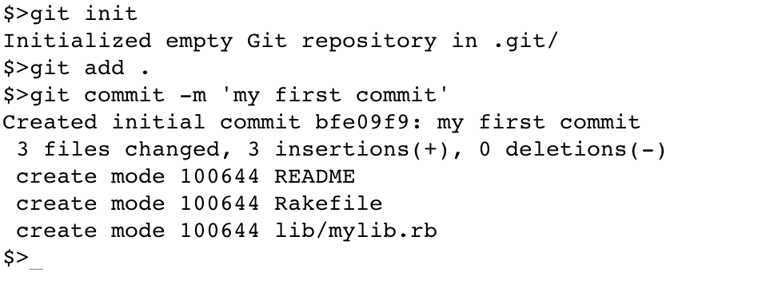

Slide 25
Notes:
Initializes an empty repo

Slide 26
Notes:
git add tells git that you'll soon want some of your recent changes (and perhaps not others) to be recorded for posterity

Slide 27
$> git status
# On branch master
#
# Initial commit
#
# Changes to be committed:
# (use "git rm --cached <file>..." to unstage)
#
# new file: README
# new file: Rakefile
# new file: lib/mylib.rb
#
Notes:
I’ll interject here that it’s always a good idea to run git status before you do something permanent, as a quick check of your grasp of the situation.

Slide 28
$> git status
# On branch master
#
# Initial commit
#
# Changes to be committed:
# (use "git rm --cached <file>..." to unstage)
#
# new file: README
# new file: Rakefile
# new file: lib/mylib.rb
#
Notes:
And there you go. It even tells you what to do if you don’t want one of those files in the next commit.

Slide 29
Notes:
Git commit takes a snapshot of the way everything is now, reusing what it can, and carves it in stone

Slide 30
Notes:
And it tells you what it did

Slide 31
Notes:
Including a shortened SHA of the commit and a summary of the changes it introduces.

Slide 32
$> git tag first_commit
$>
Notes:
And we’ll add a tag named “first_commit” for kicks.

Slide 33
git init
(work work work work)
git status
git add --all
git status
git commit
(work work work)
git status
git add …
git status
git commit
git tag
…
Notes:
This will be about the order of your normal micro workflow. Lots of working (sorry), adding, committing, and maybe an occasional tag.

Slide 34
Understanding Git
The Basics
The Git Object Database
History inspection
Branching workflows
Collaboration
Advanced Stuff
Troubleshooting
Notes:
now for a discussion of the git object database, the major component of git’s back-end,
for de-mystification purposes

Slide 35
What is Git?
$> touch README
$> git add .
$> git commit –m “initial commit”
$> tree –a .git
.git
├── COMMIT_EDITMSG
├── HEAD
├── config
├── description
├── hooks
│ ├── …
├── index
├── info
│ └── exclude
├── logs
│ ├── …
├── objects
│ ├── 54
│ │ └── 3b9bebdc6bd5c4b22136034a95dd097a57d3dd
│ ├── cc
│ │ └── 9fc8c4ea4df4f245103cbe80c35bfa2eb07e52
│ ├── e6
│ │ └── 9de29bb2d1d6434b8b29ae775ad8c2e48c5391
│ ├── info
│ └── pack
└── refs
├── heads
│ └── master
└── tags
14 directories, 20 files
Notes:
I showed you this slide earlier…

Slide 36
What is Git?
$> git init
$> touch README
$> git add .
$> git commit –m “initial commit”
$> tree –a .git
.git
├── COMMIT_EDITMSG
├── HEAD
├── config
├── description
├── hooks
│ ├── …
├── index
├── info
│ └── exclude
├── logs
│ ├── …
├── objects
│ ├── 54
│ │ └── 3b9bebdc6bd5c4b22136034a95dd097a57d3dd
│ ├── cc
│ │ └── 9fc8c4ea4df4f245103cbe80c35bfa2eb07e52
│ ├── e6
│ │ └── 9de29bb2d1d6434b8b29ae775ad8c2e48c5391
│ ├── info
│ └── pack
└── refs
├── heads
│ └── master
└── tags
14 directories, 20 files
Notes:
… sporting a git repo created using those most basic commands: git init, add and commit.

Slide 37
What is Git?
$> touch README
$> git add .
$> git commit –m “initial commit”
$> tree –a .git
.git
├── COMMIT_EDITMSG
├── HEAD
├── config
├── description
├── hooks
│ ├── …
├── index
├── info
│ └── exclude
├── logs
│ ├── …
├── objects
│ ├── 54
│ │ └── 3b9bebdc6bd5c4b22136034a95dd097a57d3dd
│ ├── cc
│ │ └── 9fc8c4ea4df4f245103cbe80c35bfa2eb07e52
│ ├── e6
│ │ └── 9de29bb2d1d6434b8b29ae775ad8c2e48c5391
│ ├── info
│ └── pack
└── refs
├── heads
│ └── master
└── tags
14 directories, 20 files
Notes:
The thing to remember as we discuss the git back-end is that all of the information from this snapshot of your work is stored in files in this “objects” directory.
We’ll return to this repository often to illustrate concepts.

Slide 38
The Git Object Database
Notes:
the Git Object Database is a content-addressable filesystem in the back-end of git

Slide 39
The Git Object Database
Key / Value <=> SHA1 / Content
Notes:
You give it some arbitrary content, and it stores it, hashes it, and gives you back the 40-char SHA1 hash key you can use to retrieve it again.

Slide 40
The Git Object Database
Key / Value <=> SHA1 / Content
All objects go under the “objects” directory under .git
.git
├── HEAD
├── config
├── description
├── hooks
│ ├── …
├── info
│ └── exclude
├── objects
│ ├── info
│ └── pack
└── refs
├── heads
└── tags
8 directories, 12 files
← there
Notes:
all objects go in subdirectories under the objects directory

Slide 41
The Git Object Database
.git
├── COMMIT_EDITMSG
├── HEAD
├── config
├── description
├── hooks
│ ├── …
├── index
├── info
│ └── exclude
├── logs
│ ├── …
├── objects
│ ├── 54
│ │ └── 3b9bebdc6bd5c4b22136034a95dd097a57d3dd
│ ├── cc
│ │ └── 9fc8c4ea4df4f245103cbe80c35bfa2eb07e52
│ ├── e6
│ │ └── 9de29bb2d1d6434b8b29ae775ad8c2e48c5391
│ ├── info
│ └── pack
└── refs
├── heads
│ └── master
└── tags
14 directories, 20 files
Notes:
and when objects are stored, the first two characters of the SHA is the directory, and the remaining characters the filename

Slide 42
The Git Object Database
Key / Value <=> SHA1 / Content
All objects go under the “objects” directory under .git
There are only four kinds of objects that Git stores during normal use:
blobs (≈files)
trees (≈directories)
commits
tags
Notes:
There are only four kinds of objects that Git stores during normal use.
but first…

Slide 43
The Git Object Database
all git objects are stored as follows
Notes:
the way all objects are stored

Slide 44
The Git Object Database
content
Notes:
when the object database is given some content to store, it prepends a small header, which is

Slide 45
The Git Object Database
content
new_content = type + ’ ‘ + content.size + \0
+ content

Slide 46
The Git Object Database
content
new_content = type + ’ ‘ + content.size + \0
+ content
sha = Digest::SHA1.hexdigest(new_content)
Notes:
it then calculates the sha1 value of that new content

Slide 47
The Git Object Database
content
new_content = type + ’ ‘ + content.size + \0
+ content
sha = Digest::SHA1.hexdigest(new_content)
“824aed035c0aa75d64c...”
Notes:
which is how it will refer to it from now on (like an inode number)

Slide 48
The Git Object Database
content
new_content = type + ’ ‘ + content.size + \0
+ content
sha = Digest::SHA1.hexdigest(new_content)
“824aed035c0aa75d64c...”
compressed = zlib::deflate(new_content)
Notes:
then zlib::deflates it,

Slide 49
The Git Object Database
content
new_content = type + ’ ‘ + content.size + \0
+ content
sha = Digest::SHA1.hexdigest(new_content)
“824aed035c0aa75d64c...”
compressed = zlib::deflate(new_content)
path = “.git/objects/82/4aed035c0aa75d64c...”
Notes:
determines it’s path by the first two characters and the rest of the sha

Slide 50
The Git Object Database
content
new_content = type + ’ ‘ + content.size + \0
+ content
sha = Digest::SHA1.hexdigest(new_content)
“824aed035c0aa75d64c...”
compressed = zlib::deflate(new_content)
path = “.git/objects/82/4aed035c0aa75d64c...”
File.open(path, ‘w’) {|f| f.write(compressed)}
Notes:
and stores the compressed data in the object database directory.

Slide 51
The Git Object Database
content
new_content = type + ’ ‘ + content.size + \0
+ content
“loose” format
sha = Digest::SHA1.hexdigest(new_content)
“824aed035c0aa75d64c...”
compressed = zlib::deflate(new_content)
path = “.git/objects/82/4aed035c0aa75d64c...”
File.open(path, ‘w’) {|f| f.write(compressed)}
Notes:
this is referred to as the “loose” format

Slide 52
The Git Object Database
git gc
Notes:
objects occasionally get stored another way
Every once in a while, the garbage collector is run automatically.

Slide 53
The Git Object Database
git gc
same file with minor differences
Notes:
Many housekeeping tasks are done,

Slide 54
The Git Object Database
git gc
same file with minor differences
.git/objects/82/4aed035c0aa75d64c...
.git/objects/1d/c9cbcb76cbb80fce1...
.git/objects/63/874f37013c1740acd...
.git/objects/04/fb8aee105e6e445e8...
.git/objects/45/b983be36b73c0788d...
.git/objects/f1/032eed02413a1145c...
Notes:
one of which is that whenever git can detect that a bunch of snapshots are of the same file with minor differences,

Slide 55
The Git Object Database
git gc
same file with minor differences
.git/objects/82/4aed035c0aa75d64c...
.git/objects/1d/c9cbcb76cbb80fce1...
.git/objects/63/874f37013c1740acd...
.git/objects/04/fb8aee105e6e445e8...
.git/objects/45/b983be36b73c0788d...
.git/objects/f1/032eed02413a1145c...
.git/objects/pack/pack-999727..9f600.pack
.git/objects/pack/pack-999727..9f600.idx
Notes:
It will collect and delta-compress them into a “pack” file and index.

Slide 56
The Git Object Database
git gc
same file with minor differences
.git/objects/82/4aed035c0aa75d64c...
.git/objects/1d/c9cbcb76cbb80fce1...
.git/objects/63/874f37013c1740acd...
.git/objects/04/fb8aee105e6e445e8...
.git/objects/45/b983be36b73c0788d...
.git/objects/f1/032eed02413a1145c...
.git/objects/pack/pack-999727..9f600.pack
.git/objects/pack/pack-999727..9f600.idx
Notes:
These are stored separately from the loose objects, in .git/objects/pack.

Slide 57
The Git Object Database
git gc
same file with minor differences
“packed” format
.git/objects/82/4aed035c0aa75d64c...
.git/objects/1d/c9cbcb76cbb80fce1...
.git/objects/63/874f37013c1740acd...
.git/objects/04/fb8aee105e6e445e8...
.git/objects/45/b983be36b73c0788d...
.git/objects/f1/032eed02413a1145c...
.git/objects/pack/pack-999727..9f600.pack
.git/objects/pack/pack-999727..9f600.idx
Notes:
As you’ve probably guessed, this is called the “packed” format.

Slide 58
The Git Object Database
There are only four types of Git objects
Notes:
now back to this
there are only four types of git objects that can be stored in the database

Slide 59
The Git Object Database
blob
Notes:
the blob

Slide 60
The Git Object Database
blob
tree
Notes:
the tree

Slide 61
The Git Object Database
blob
tree
commit
Notes:
the commit

Slide 62
The Git Object Database
blob
tree
commit
tag
Notes:
and the tag. first, we’ll cover

Slide 63
The Git Object Database
blob
Notes:
the blob

Slide 64
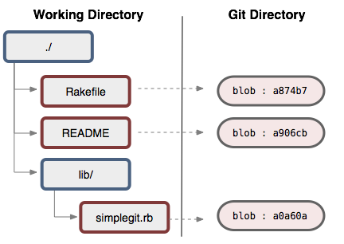
The Git Object Database
blob
Notes:
If you have a working directory that looks like this,

Slide 65
The Git Object Database
blob
Notes:
Then the blobs are the git object database equivalent of the files.

Slide 66
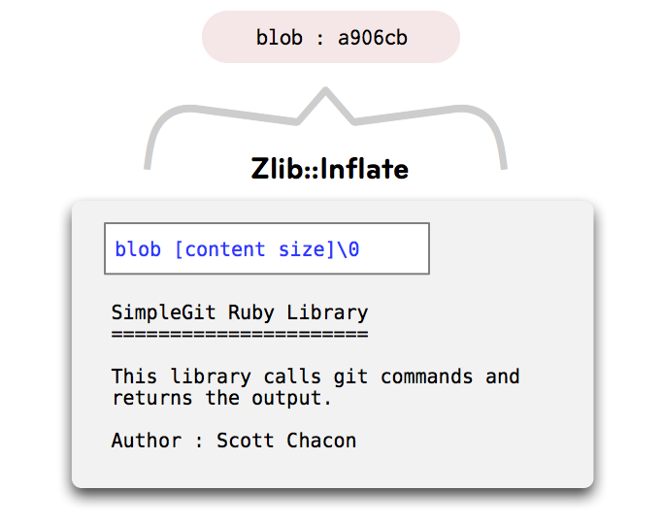
The Git Object Database
zlib::deflate
Notes:
So say you have a little README file in a project called “SimpleGit”, and you’ve committed it to the repository.

Slide 67
The Git Object Database
zlib::deflate
content
Notes:
The content is simply text,

Slide 68
The Git Object Database
zlib::deflate
header
content
Notes:
As mentioned before the header has the string “blob”, a space, the content size, and a null-byte,

Slide 69
The Git Object Database
compress
zlib::deflate
header
content
Notes:
It’s compressed,

Slide 70
The Git Object Database
object
compress
zlib::deflate
header
content
Notes:
and handed to the Git Object Database, where it’s assigned a SHA.

Slide 71
The Git Object Database
blob
tree
commit
tag
Notes:
Next up,

Slide 72
The Git Object Database
tree
Notes:
Trees

Slide 73
The Git Object Database
tree
Notes:
if the files correspond to “blob”s

Slide 74
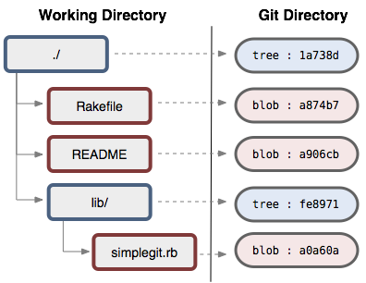
The Git Object Database
tree
Notes:
the directories are “trees”

Slide 75
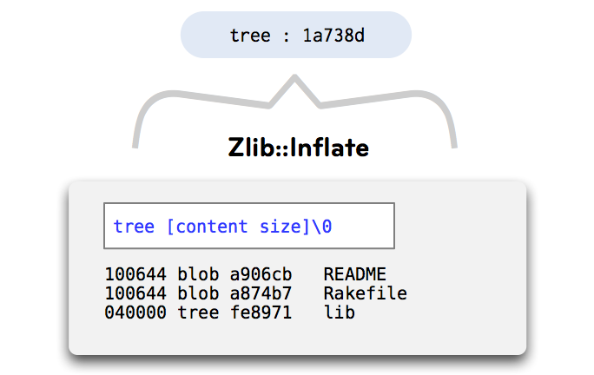
The Git Object Database
zlib::deflate
Notes:
this. for you posix geeks, they are sort of a combination of

Slide 76
The Git Object Database
zlib::deflate
“inode” info
filename
Notes:
the posix directory data

Slide 77
The Git Object Database
zlib::deflate
mode
type
“block pointer”
Notes:
and a subset of the inode information itself, smushed together into one object

Slide 78
The Git Object Database
blob
tree
commit
tag
Notes:
now, the third object is the “commit”

Slide 79
The Git Object Database
commit
Notes:
now, the third object is the “commit”

Slide 80
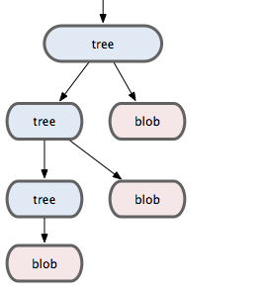
The Git Object Database
commit
Notes:
a commit object points to the root tree of your project

Slide 81
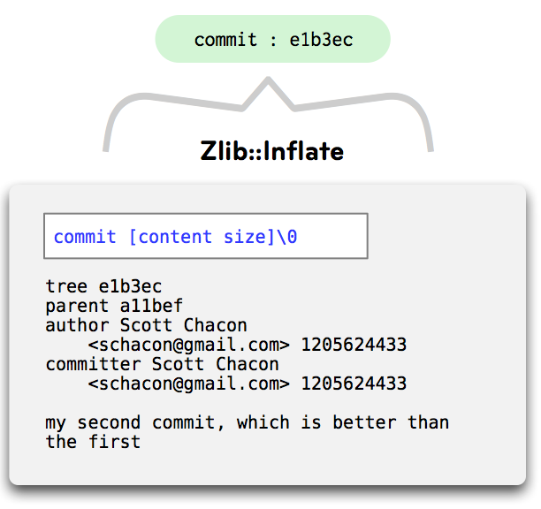
The Git Object Database
zlib::deflate
Notes:
and stores a bunch of meta-information about that particular snapshot of content, including

Slide 82
The Git Object Database
zlib::deflate
Notes:
the commit message

Slide 83
The Git Object Database
zlib::deflate
Notes:
the author and committer and the date-times it was authored and committed

Slide 84
The Git Object Database
zlib::deflate
Notes:
a pointer to the previous commit or commits (if it is a merge)

Slide 85
The Git Object Database
zlib::deflate
Notes:
and a pointer to the root tree of the project

Slide 86
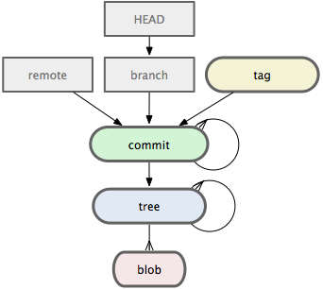
The Git Object Database
Notes:
which gives us a directed acyclic graph like this

Slide 87
The Git Object Database
blob
tree
commit
tag
Notes:
no now, we come to the last object, the “tag”

Slide 88
The Git Object Database
tag
Notes:
no now, we come to the last object, the “tag”

Slide 89
The Git Object Database
tag
Notes:
a tag object points to a commit, to provide a way to reference a commit object by a human readable string, rather than a sha value

Slide 90
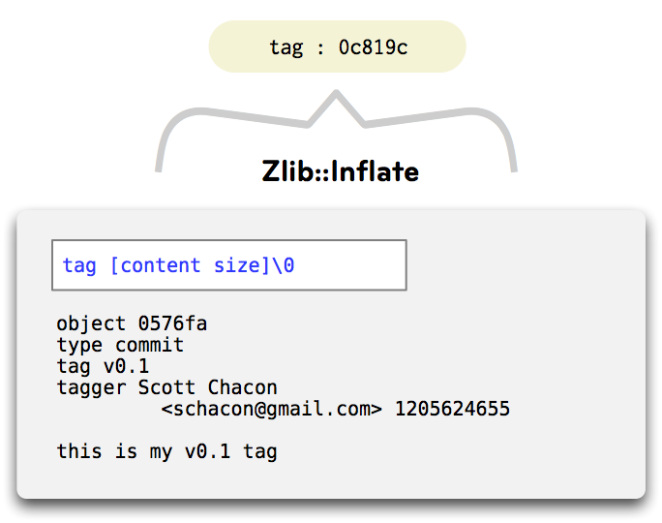
The Git Object Database
zlib::deflate
Notes:
the commit object contains

Slide 91
The Git Object Database
zlib::deflate
Notes:
a tag message

Slide 92
The Git Object Database
zlib::deflate
Notes:
a tagger and date

Slide 93
The Git Object Database
zlib::deflate
Notes:
a tag string

Slide 94
The Git Object Database
zlib::deflate
Notes:
and the object you’re tagging, which is normally a commit

Slide 95
The Git Object Database
$> git init
$> touch README
$> git add .
$> git commit –m “initial commit”
$> tree –a .git
.git
├── COMMIT_EDITMSG
├── HEAD
├── config
├── description
├── hooks
│ ├── …
├── index
├── info
│ └── exclude
├── logs
│ ├── …
├── objects
│ ├── 54
│ │ └── 3b9bebdc6bd5c4b22136034a95dd097a57d3dd
│ ├── cc
│ │ └── 9fc8c4ea4df4f245103cbe80c35bfa2eb07e52
│ ├── e6
│ │ └── 9de29bb2d1d6434b8b29ae775ad8c2e48c5391
│ ├── info
│ └── pack
└── refs
├── heads
│ └── master
└── tags
14 directories, 20 files
Notes:
Now I intend to rapidly reconnect all this theoretical information to our concrete repository.

Slide 96
The Git Object Database
$> git init
$> touch README
$> git add .
$> git commit –m “initial commit”
$> git tag –a taggy
(opens editor to write annotation)
$> tree –a .git
.git
├── COMMIT_EDITMSG
├── HEAD
├── config
├── description
├── hooks
│ ├── …
├── index
├── info
│ └── exclude
├── logs
│ ├── …
├── objects
│ ├── 54
│ │ └── 3b9bebdc6bd5c4b22136034a95dd097a57d3dd
│ ├── c7
│ │ └── dcf9ef54b124542e958c62866d8724471d77d2
│ ├── cc
│ │ └── 9fc8c4ea4df4f245103cbe80c35bfa2eb07e52
│ ├── e6
│ │ └── 9de29bb2d1d6434b8b29ae775ad8c2e48c5391
│ ├── info
│ └── pack
└── refs
├── heads
│ └── master
└── tags
└── taggy
15 directories, 22 files
Notes:
First we’ll add an annotated tag, which adds a new object to the object database.

Slide 97
The Git Object Database
$> git init
$> touch README
$> git add .
$> git commit –m “initial commit”
$> git tag –a taggy
(opens editor to write annotation)
$> tree –a .git
.git
├── COMMIT_EDITMSG
├── HEAD
├── config
├── description
├── hooks
│ ├── …
├── index
├── info
│ └── exclude
├── logs
│ ├── …
├── objects
│ ├── 54
│ │ └── 3b9bebdc6bd5c4b22136034a95dd097a57d3dd
│ ├── c7
│ │ └── dcf9ef54b124542e958c62866d8724471d77d2
│ ├── cc
│ │ └── 9fc8c4ea4df4f245103cbe80c35bfa2eb07e52
│ ├── e6
│ │ └── 9de29bb2d1d6434b8b29ae775ad8c2e48c5391
│ ├── info
│ └── pack
└── refs
├── heads
│ └── master
└── tags
└── taggy
15 directories, 22 files
Notes:
Now we’ll peek into each of these objects to give you an intuition about what git is doing for you with these commands.

Slide 98
The Git Object Database
.git
├── COMMIT_EDITMSG
├── HEAD
├── config
├── description
├── hooks
│ ├── …
├── index
├── info
│ └── exclude
├── logs
│ ├── …
├── objects
│ ├── 54
│ │ └── 3b9bebdc6bd5c4b22136034a95dd097a57d3dd
│ ├── c7
│ │ └── dcf9ef54b124542e958c62866d8724471d77d2
│ ├── cc
│ │ └── 9fc8c4ea4df4f245103cbe80c35bfa2eb07e52
│ ├── e6
│ │ └── 9de29bb2d1d6434b8b29ae775ad8c2e48c5391
│ ├── info
│ └── pack
└── refs
├── heads
│ └── master
└── tags
└── taggy
15 directories, 22 files

Slide 99
The Git Object Database
.git
├── COMMIT_EDITMSG
├── HEAD
├── config
├── description
├── hooks
│ ├── …
├── index
├── info
│ └── exclude
├── logs
│ ├── …
├── objects
│ ├── 54
│ │ └── 3b9bebdc6bd5c4b22136034a95dd097a57d3dd
│ ├── c7
│ │ └── dcf9ef54b124542e958c62866d8724471d77d2
│ ├── cc
│ │ └── 9fc8c4ea4df4f245103cbe80c35bfa2eb07e52
│ ├── e6
│ │ └── 9de29bb2d1d6434b8b29ae775ad8c2e48c5391
│ ├── info
│ └── pack
└── refs
├── heads
│ └── master
└── tags
└── taggy
15 directories, 22 files
$> git cat-file –p c7dcf9ef54b124542e958c62866d8724471d77d2
object cc9fc8c4ea4df4f245103cbe80c35bfa2eb07e52
type commit
tag taggy
tagger Daniel Cox <daniel.cox@six3systems.com> Sat Jan 5 23:47:45 2013 -0500
a thrilling annotation message
$>
the tag pointing to the commit
Notes:
cat-file –p is a plumbing command that allows you to peek into a commit given its SHA.
It just so happens that the object I asked to see was the tag, which shows what object it points to, some meta information, and the annotation message, as discussed earlier.

Slide 100
The Git Object Database
.git
├── COMMIT_EDITMSG
├── HEAD
├── config
├── description
├── hooks
│ ├── …
├── index
├── info
│ └── exclude
├── logs
│ ├── …
├── objects
│ ├── 54
│ │ └── 3b9bebdc6bd5c4b22136034a95dd097a57d3dd
│ ├── c7
│ │ └── dcf9ef54b124542e958c62866d8724471d77d2
│ ├── cc
│ │ └── 9fc8c4ea4df4f245103cbe80c35bfa2eb07e52
│ ├── e6
│ │ └── 9de29bb2d1d6434b8b29ae775ad8c2e48c5391
│ ├── info
│ └── pack
└── refs
├── heads
│ └── master
└── tags
└── taggy
15 directories, 22 files
$> git cat-file –p c7dcf9ef54b124542e958c62866d8724471d77d2
object cc9fc8c4ea4df4f245103cbe80c35bfa2eb07e52
type commit
tag taggy
tagger Daniel Cox <daniel.cox@six3systems.com> Sat Jan 5 23:47:45 2013 -0500
a thrilling annotation message
$>
the tag pointing to the commit
Notes:
Now we’ll open the object it points to, which should be the commit…

Slide 101
The Git Object Database
.git
├── COMMIT_EDITMSG
├── HEAD
├── config
├── description
├── hooks
│ ├── …
├── index
├── info
│ └── exclude
├── logs
│ ├── …
├── objects
│ ├── 54
│ │ └── 3b9bebdc6bd5c4b22136034a95dd097a57d3dd
│ ├── c7
│ │ └── dcf9ef54b124542e958c62866d8724471d77d2
│ ├── cc
│ │ └── 9fc8c4ea4df4f245103cbe80c35bfa2eb07e52
│ ├── e6
│ │ └── 9de29bb2d1d6434b8b29ae775ad8c2e48c5391
│ ├── info
│ └── pack
└── refs
├── heads
│ └── master
└── tags
└── taggy
15 directories, 22 files
$> git cat-file –p cc9fc8c4ea4df4f245103cbe80c35bfa2eb07e52

Slide 102
The Git Object Database
.git
├── COMMIT_EDITMSG
├── HEAD
├── config
├── description
├── hooks
│ ├── …
├── index
├── info
│ └── exclude
├── logs
│ ├── …
├── objects
│ ├── 54
│ │ └── 3b9bebdc6bd5c4b22136034a95dd097a57d3dd
│ ├── c7
│ │ └── dcf9ef54b124542e958c62866d8724471d77d2
│ ├── cc
│ │ └── 9fc8c4ea4df4f245103cbe80c35bfa2eb07e52
│ ├── e6
│ │ └── 9de29bb2d1d6434b8b29ae775ad8c2e48c5391
│ ├── info
│ └── pack
└── refs
├── heads
│ └── master
└── tags
└── taggy
15 directories, 22 files
$> git cat-file –p cc9fc8c4ea4df4f245103cbe80c35bfa2eb07e52
tree 543b9bebdc6bd5c4b22136034a95dd097a57d3dd
author Daniel Cox <daniel.cox@six3systems.com> 1357417822 -0500
committer Daniel Cox <daniel.cox@six3systems.com> 1357417822 -0500
init
$>
the commit pointing to the tree
Notes:
It is.
The commit contains the SHA of the tree it points to, some meta information, and the commit message.

Slide 103
The Git Object Database
.git
├── COMMIT_EDITMSG
├── HEAD
├── config
├── description
├── hooks
│ ├── …
├── index
├── info
│ └── exclude
├── logs
│ ├── …
├── objects
│ ├── 54
│ │ └── 3b9bebdc6bd5c4b22136034a95dd097a57d3dd
│ ├── c7
│ │ └── dcf9ef54b124542e958c62866d8724471d77d2
│ ├── cc
│ │ └── 9fc8c4ea4df4f245103cbe80c35bfa2eb07e52
│ ├── e6
│ │ └── 9de29bb2d1d6434b8b29ae775ad8c2e48c5391
│ ├── info
│ └── pack
└── refs
├── heads
│ └── master
└── tags
└── taggy
15 directories, 22 files
$> git cat-file –p cc9fc8c4ea4df4f245103cbe80c35bfa2eb07e52
tree 543b9bebdc6bd5c4b22136034a95dd097a57d3dd
author Daniel Cox <daniel.cox@six3systems.com> 1357417822 -0500
committer Daniel Cox <daniel.cox@six3systems.com> 1357417822 -0500
init
$>
the commit pointing to the tree
Notes:
In any commit but the first one, the commit would have a “parent” line, pointing to the SHA of the commit that came immediately before it, here.

Slide 104
The Git Object Database
.git
├── COMMIT_EDITMSG
├── HEAD
├── config
├── description
├── hooks
│ ├── …
├── index
├── info
│ └── exclude
├── logs
│ ├── …
├── objects
│ ├── 54
│ │ └── 3b9bebdc6bd5c4b22136034a95dd097a57d3dd
│ ├── c7
│ │ └── dcf9ef54b124542e958c62866d8724471d77d2
│ ├── cc
│ │ └── 9fc8c4ea4df4f245103cbe80c35bfa2eb07e52
│ ├── e6
│ │ └── 9de29bb2d1d6434b8b29ae775ad8c2e48c5391
│ ├── info
│ └── pack
└── refs
├── heads
│ └── master
└── tags
└── taggy
15 directories, 22 files
$> git cat-file –p cc9fc8c4ea4df4f245103cbe80c35bfa2eb07e52
tree 543b9bebdc6bd5c4b22136034a95dd097a57d3dd
author Daniel Cox <daniel.cox@six3systems.com> 1357417822 -0500
committer Daniel Cox <daniel.cox@six3systems.com> 1357417822 -0500
init
$>
the commit pointing to the tree
Notes:
Let’s open the tree this commit points to next.

Slide 105
The Git Object Database
.git
├── COMMIT_EDITMSG
├── HEAD
├── config
├── description
├── hooks
│ ├── …
├── index
├── info
│ └── exclude
├── logs
│ ├── …
├── objects
│ ├── 54
│ │ └── 3b9bebdc6bd5c4b22136034a95dd097a57d3dd
│ ├── c7
│ │ └── dcf9ef54b124542e958c62866d8724471d77d2
│ ├── cc
│ │ └── 9fc8c4ea4df4f245103cbe80c35bfa2eb07e52
│ ├── e6
│ │ └── 9de29bb2d1d6434b8b29ae775ad8c2e48c5391
│ ├── info
│ └── pack
└── refs
├── heads
│ └── master
└── tags
└── taggy
15 directories, 22 files
$> git cat-file –p 543b9bebdc6bd5c4b22136034a95dd097a57d3dd

Slide 106
The Git Object Database
.git
├── COMMIT_EDITMSG
├── HEAD
├── config
├── description
├── hooks
│ ├── …
├── index
├── info
│ └── exclude
├── logs
│ ├── …
├── objects
│ ├── 54
│ │ └── 3b9bebdc6bd5c4b22136034a95dd097a57d3dd
│ ├── c7
│ │ └── dcf9ef54b124542e958c62866d8724471d77d2
│ ├── cc
│ │ └── 9fc8c4ea4df4f245103cbe80c35bfa2eb07e52
│ ├── e6
│ │ └── 9de29bb2d1d6434b8b29ae775ad8c2e48c5391
│ ├── info
│ └── pack
└── refs
├── heads
│ └── master
└── tags
└── taggy
15 directories, 22 files
$> git cat-file –p 543b9bebdc6bd5c4b22136034a95dd097a57d3dd
100644 blob e69de29bb2d1d6434b8b29ae775ad8c2e48c5391 README
$>
the tree with one file in it
Notes:
The tree contains one blob, and when that blob is checked out into the working directory, it will be named README.

Slide 107
The Git Object Database
.git
├── COMMIT_EDITMSG
├── HEAD
├── config
├── description
├── hooks
│ ├── …
├── index
├── info
│ └── exclude
├── logs
│ ├── …
├── objects
│ ├── 54
│ │ └── 3b9bebdc6bd5c4b22136034a95dd097a57d3dd
│ ├── c7
│ │ └── dcf9ef54b124542e958c62866d8724471d77d2
│ ├── cc
│ │ └── 9fc8c4ea4df4f245103cbe80c35bfa2eb07e52
│ ├── e6
│ │ └── 9de29bb2d1d6434b8b29ae775ad8c2e48c5391
│ ├── info
│ └── pack
└── refs
├── heads
│ └── master
└── tags
└── taggy
15 directories, 22 files
$> git cat-file –p e69de29bb2d1d6434b8b29ae775ad8c2e48c5391
$>
the empty file blob
Notes:
And here’s that empty blob.

Slide 108
Understanding Git
The Basics
The Git Object Database
History inspection
Branching workflows
Collaboration
Advanced Stuff
Troubleshooting

Slide 109
History Inspection
Notes:
History Inspection.
So, now you know how to record the history of your project as you work, and what git is doing for you, but for that information to be useful we’ll need to be able to inspect the history we’ve created.

Slide 110
History Inspection
git log
shows you a nice ordered list of your commits and their messages
git diff
allows you to see the difference between two versions of a file, or between two entire commits
git show
ask to see something git is holding for you. commits, trees, tags, blobs, and any treeish
Notes:
so we’ll add three new commands, git log, diff and show

Slide 111
git log

Slide 112
Notes:
git log, without any arguments

Slide 113
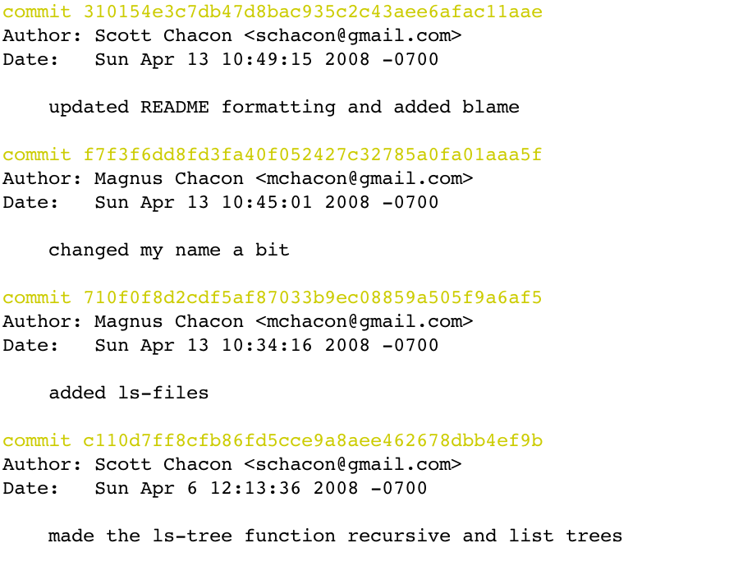
Notes:
prints out a pretty nice history of your commits in reverse order

Slide 114
Notes:
or, there are many options you can pass to reformat the logs or get more information from them

Slide 115
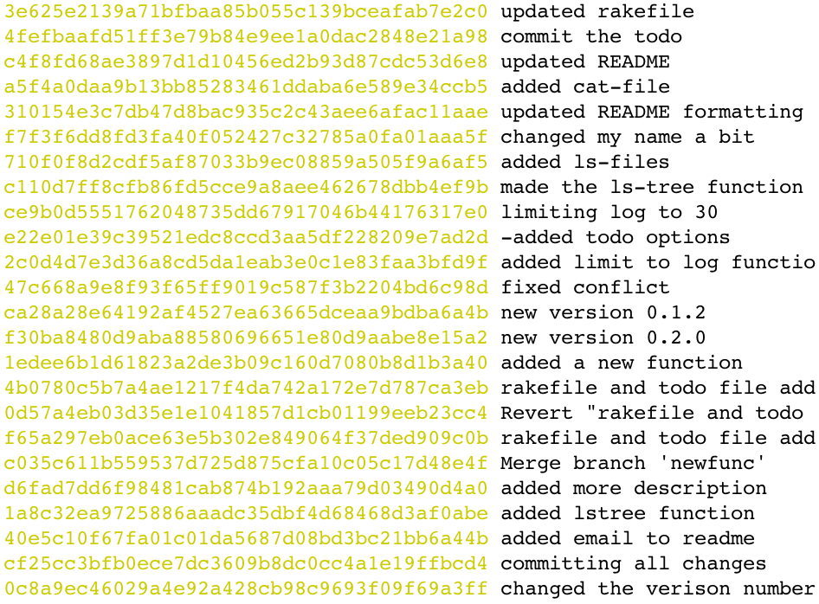

Slide 116
Notes:
you can also make up your own format

Slide 117
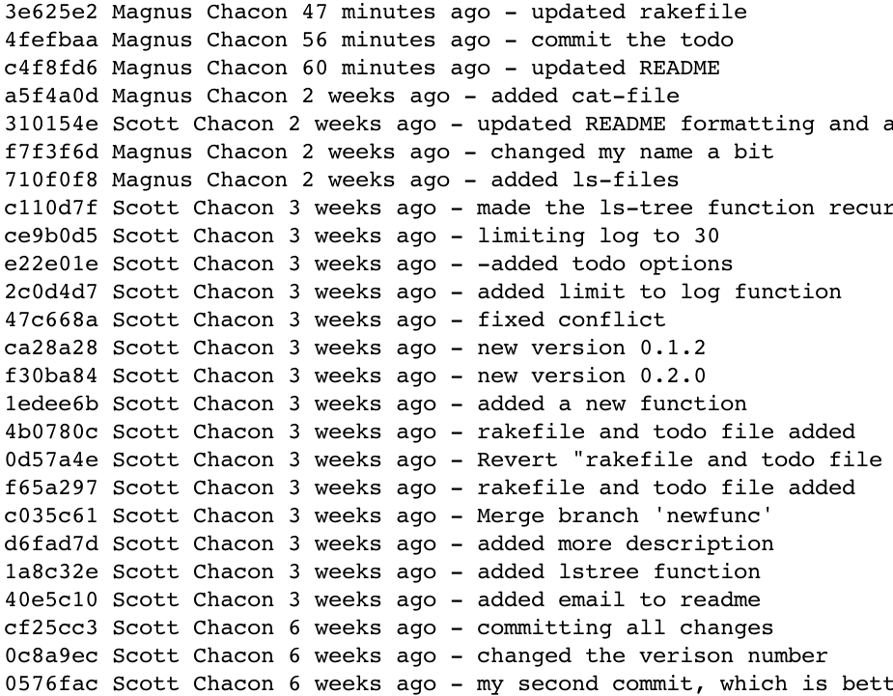

Slide 118
Notes:
in this one we have a shortened SHA,

Slide 119
Notes:
the commit author, etc.

Slide 120
git diff
Notes:
git diff

Slide 121
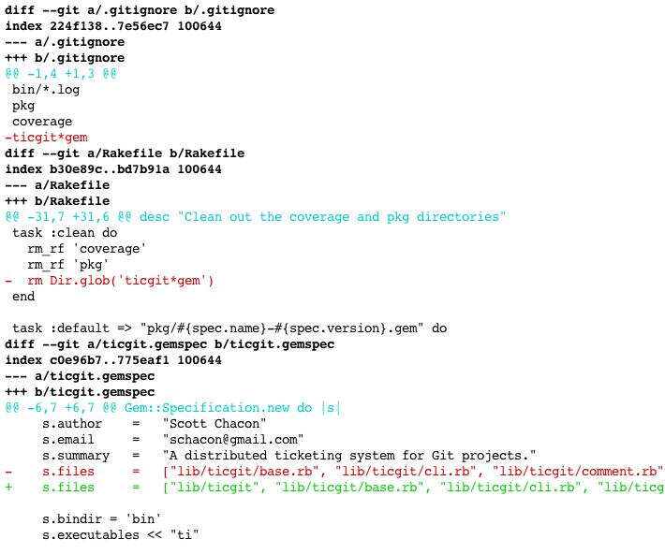
git diff (treeish1) (treeish2)
Notes:
git diff will actually give you a nice unified diff of two files or of states of your repository, or of the changes you’ve made since you last git-added anything…
But what’s a treeish?

Slide 122
the treeish

Slide 123
the treeish
alternate ways to refer to
objects or ranges of objects
Notes:
they’re a big bag of different ways to refer to a commit or commits …
(which you should remember are just snapshots of the way your working directory is or was)

Slide 124
Treeish
full sha-1
partial sha-1
branch or tag name
date spec
ordinal spec
carrot parent
tilde spec
tree pointer
blob spec
ranges

Slide 125
Full SHA1
6e453f523fa1da50ecb04431101112b3611c6a4d

Slide 126
Partial SHA1
6e453f523fa1da50ecb04431101112b3611c6a4d
6e453f523fa1da50
6e453

Slide 127
Branch, Remote or Tag Name
v1.0
master
origin/testing

Slide 128
Date Spec
master@{yesterday}
master@{1 month ago}

Slide 129
Ordinal Spec
master@{5}
5th prior value of ‘master’

Slide 130
Carrot Parent
master^2
2nd parent of ‘master’
Notes:
This one will make sense later when we talk about merges, and thus commits that can have multiple parent commits.

Slide 131
Tilde Spec
master~2
2nd generation grandparent of ‘master’

Slide 132
Tree Pointer
master^{tree}
tree that ‘master’ points to

Slide 133
Blob Spec
master:/path/to/file
blob of that file in ‘master’ commit

Slide 134
Ranges
ce0e4..e4272
everything between two commits

Slide 135
Ranges
ce0e4..
everything since a commit

Slide 136
One Especially Useful One
origin/master..HEAD
or just
origin/master..
everything you’ve done since the last time you pulled
Notes:
to get ahead of ourselves a little bit, here’s one especially useful range which will allow you to preview what you’re about to push
use with git log, or with git diff if you need a bit more detail

Slide 137
History Inspection
git log
git diff
git show
Notes:
git show.
git show will try to show you something useful for whatever treeish you give it.

Slide 138
History Inspection
git log
git diff
git show
$> git show taggy
tag taggy
Tagger: Daniel Cox <daniel.cox@six3systems.com>
Date: Sat Jan 5 23:47:45 2013 -0500
a thrilling annotation message
commit cc9fc8c4ea4df4f245103cbe80c35bfa2eb07e52
Author: Daniel Cox <daniel.cox@six3systems.com>
Date: Sat Jan 5 15:30:22 2013 -0500
init
diff --git a/README b/README
new file mode 100644
index 0000000..e69de29
Notes:
So if you give it a tag, such as the one we made earlier, we get the tag information, the information for the commit it points to, and a diff of what that commit introduces.

Slide 139
Understanding Git
The Basics
The Git Object Database
History inspection
Branching workflows
Collaboration
Advanced Stuff
Troubleshooting

Slide 140
Branching Workflows
Notes:
Now we control our present and remember our past, but what of the future.
Of course we'll be working on several things at once, and what we're working on now will probably be different than what we have in production, or even what our colleagues are basing their work off of.
We need the concept of branches to make that easier, and so git supplies very cheap branching

Slide 141
Branching Workflows
git branch
git checkout
git merge
git rebase

Slide 142
Branching Workflows
git branch
list, create or delete branches
Notes:
git branch lists, creates or deletes branches

Slide 143
Branching Workflows
git branch
list, create or delete branches
$> git branch new_branch
$>
Notes:
here’s the creation of a new branch

Slide 144
Branching Workflows
git branch
list, create or delete branches
$> git branch
* master
new_branch
Notes:
the listing of the branches, with a little asterisk there to show you which branch you’re currently “on”

Slide 145
Branching Workflows
git branch
list, create or delete branches
Gentle
$> git branch -d new_branch
$>
Drastic
$> git branch -D new_branch
$>
Notes:
and deletion of branches
little-d delete will only successfully delete the branch you name if the branch you’re on already “contains” all the same commits.
big-D delete nukes the branch no matter what, which is less drastic than it might sound, since the actual orphaned commits aren’t actually removed for months.
deleting a branch only deletes the branch reference.

Slide 146
Branch Reference?
Notes:
What’s a branch reference?

Slide 147
Branch Reference?
blob
tree
commit
tag
Notes:
You’ll recall that there are only four types of objects in the object database.

Slide 148
No Branch References Here
blob
tree
immutable
commit
tag
Notes:
All of these objects are immutable. That’s a problem, since the closest thing we have so far to a named branch reference is a tag,

Slide 149
No Branch References Here
blob
tree
immutable
commit
tag
can’t be muted
Notes:
and when we’re “on” a particular branch… and we commit, clearly we want the branch to change and point to the latest commit.
we need a named pointer to the last commit on an ever-growing branch of commits

Slide 150
References
lightweight, movable
pointers to a commit
Notes:
so git has references, which are lightweight, easily movable pointers to a commit that signifies the head of a local or remote branch

Slide 151
References
lightweight, movable
pointers to a commit
stored in .git/refs/*
as simple files
Notes:
they’re stored in .git/refs

Slide 152
References
.git
├── COMMIT_EDITMSG
├── HEAD
├── config
├── description
├── hooks
│ ├── …
├── index
├── info
│ └── exclude
├── logs
│ ├── …
├── objects
│ ├── 54
│ │ └── 3b9bebdc6bd5c4b22136034a95dd097a57d3dd
│ ├── c7
│ │ └── dcf9ef54b124542e958c62866d8724471d77d2
│ ├── cc
│ │ └── 9fc8c4ea4df4f245103cbe80c35bfa2eb07e52
│ ├── e6
│ │ └── 9de29bb2d1d6434b8b29ae775ad8c2e48c5391
│ ├── info
│ └── pack
└── refs
├── heads
│ ├── master
│ └── new_branch
└── tags
└── taggy
15 directories, 24 files

Slide 153
References
.git
├── COMMIT_EDITMSG
├── HEAD
├── config
├── description
├── hooks
│ ├── …
├── index
├── info
│ └── exclude
├── logs
│ ├── …
├── objects
│ ├── 54
│ │ └── 3b9bebdc6bd5c4b22136034a95dd097a57d3dd
│ ├── c7
│ │ └── dcf9ef54b124542e958c62866d8724471d77d2
│ ├── cc
│ │ └── 9fc8c4ea4df4f245103cbe80c35bfa2eb07e52
│ ├── e6
│ │ └── 9de29bb2d1d6434b8b29ae775ad8c2e48c5391
│ ├── info
│ └── pack
└── refs
├── heads
│ ├── master
│ └── new_branch
└── tags
└── taggy
15 directories, 24 files
← Which branch you’re “on”
← Branch References!

Slide 154
References
.git
├── COMMIT_EDITMSG
├── HEAD
├── config
├── description
├── hooks
│ ├── …
├── index
├── info
│ └── exclude
├── logs
│ ├── …
├── objects
│ ├── 54
│ │ └── 3b9bebdc6bd5c4b22136034a95dd097a57d3dd
│ ├── c7
│ │ └── dcf9ef54b124542e958c62866d8724471d77d2
│ ├── cc
│ │ └── 9fc8c4ea4df4f245103cbe80c35bfa2eb07e52
│ ├── e6
│ │ └── 9de29bb2d1d6434b8b29ae775ad8c2e48c5391
│ ├── info
│ └── pack
└── refs
├── heads
│ ├── master
│ └── new_branch
└── tags
└── taggy
15 directories, 24 files
← Which branch you’re “on”
$> cat .git/HEAD
ref: refs/heads/master
← Branch References!
$> cat .git/refs/heads/master
cc9fc8c4ea4df4f245103cbe80c35bfa2eb07e52
Notes:
and this is important: the references themselves contain just one thing, in plain text: the SHA of the commit they point to.
HEAD, in the root of .git, is the only way git knows which branch or commit you’re currently “on”, and it too is a plaintext file which just specifies which ref (or commit) it should go to.

Slide 155
The Complete Git Data Model
Notes:
now we have our complete Git data model.
there is nothing more to the back-end than this

Slide 156
Branching Workflows
.git
├── COMMIT_EDITMSG
├── HEAD
├── config
├── description
├── hooks
│ ├── …
├── index
├── info
│ └── exclude
├── logs
│ ├── …
├── objects
│ ├── 54
│ │ └── 3b9bebdc6bd5c4b22136034a95dd097a57d3dd
│ ├── c7
│ │ └── dcf9ef54b124542e958c62866d8724471d77d2
│ ├── cc
│ │ └── 9fc8c4ea4df4f245103cbe80c35bfa2eb07e52
│ ├── e6
│ │ └── 9de29bb2d1d6434b8b29ae775ad8c2e48c5391
│ ├── info
│ └── pack
└── refs
├── heads
│ ├── master
│ └── new_branch
└── tags
└── taggy
15 directories, 24 files
← Which branch you’re “on”
$> cat .git/HEAD
ref: refs/heads/master
Notes:
but back to this slide for a second, since we’re about to talk about git checkout.
the main point of git checkout is to change the HEAD file to point to something else, and then update the working directory to match.

Slide 157
Branching Workflows
.git
├── COMMIT_EDITMSG
├── HEAD
├── config
├── description
├── hooks
│ ├── …
├── index
├── info
│ └── exclude
├── logs
│ ├── …
├── objects
│ ├── 54
│ │ └── 3b9bebdc6bd5c4b22136034a95dd097a57d3dd
│ ├── c7
│ │ └── dcf9ef54b124542e958c62866d8724471d77d2
│ ├── cc
│ │ └── 9fc8c4ea4df4f245103cbe80c35bfa2eb07e52
│ ├── e6
│ │ └── 9de29bb2d1d6434b8b29ae775ad8c2e48c5391
│ ├── info
│ └── pack
└── refs
├── heads
│ ├── master
│ └── new_branch
└── tags
└── taggy
15 directories, 24 files
← Which branch you’re “on”
$> cat .git/HEAD
ref: refs/heads/master
$> git checkout new_branch
Switched to branch ‘new_branch’
$> cat .git/HEAD
ref: refs/heads/new_branch
Notes:
so here I checkout new_branch, and
because the current branch is now new_branch, if we made changes to our files and committed them, the contents of new_branch would update to the new commit’s SHA, but master would not

Slide 158
Branching Workflows
Two notes:
git checkout –b yet_another_branch
“checkout” is different in subversion
Notes:
as an aside, there are many shortcuts in git, and one relevant one here is that you can create a branch and check it out in a single command with git checkout –b
also, in case you were wondering, we’ve covered many things recently that are quite different from subversion, and “checkout” is a pretty radical one. checkout clearly does not mean the same thing in git as it does in subversion, if you’re familiar with that VCS.

Slide 159
Branching Workflows
git branch
git checkout
git merge
git rebase

Slide 160
Branching and Merging
Notes:
Branching and Merging

Slide 161
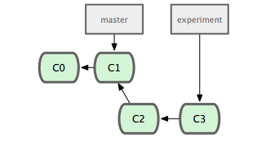
HEAD
Notes:
say we have a repository with two commits.
the master branch is at C1, which is also the current branch

Slide 162
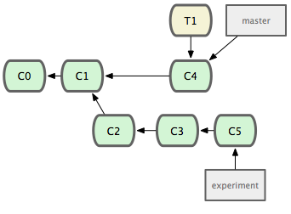
git checkout -b experiment
HEAD
Notes:
we make a new branch and check it out

Slide 163
git commit
HEAD
Notes:
and we do some work, and commit,
and the branch we’re on advances as we do

Slide 164
git commit
git commit
HEAD
Notes:
more work

Slide 165
HEAD
git checkout master
Notes:
now we checkout master

Slide 166
git commit
HEAD
Notes:
and do some work on that branch

Slide 167
git tag -a ‘v1.1’
HEAD
Notes:
and we’ll add a tag

Slide 168
git checkout experiment
git commit
HEAD
Notes:
checkout experiment branch again and do some work,
and at this point, we decide the experiment was successful, and we’d like to merge it back into master so people can take advantage of it

Slide 169
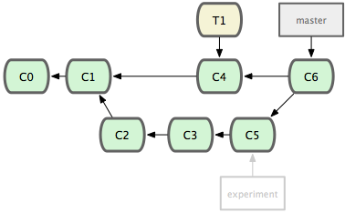
HEAD
git checkout master
git merge experiment
Notes:
we checkout master, since that’s the branch we want to merge onto,
and we merge in the experiment branch.
all this means is that the files are merged, and a new commit is (usually) recorded to log that it was done
So… the files from the source branch tree that aren’t already on the target tree are merged in, and where a file was changed in both, the conflict is resolved automatically or manually

Slide 170
Merge Conflicts
<<<<<<< targetbranchSHA
target branch changes
foo foo foo
=======
source branch changes
bar bar bar
>>>>>>> sourcebranchSHA
Notes:
if git ever has trouble merging files, usually because two branches made different changes to the same place in the same file,
it’ll put these markers in the file, and you just have to

Slide 171
Merge Conflicts
<<<<<<< targetbranchSHA
target branch changes
foo foo foo
=======
source branch changes
bar bar bar
>>>>>>> sourcebranchSHA
Notes:
manually edit the file the way you want it and delete the markers

Slide 172
Merge Conflicts
foo foo foo
bar bar bar
$> git add whatever_file
$> git commit
Notes:
and then save,
git add them to mark them resolved,
and commit them, and all will be well.
the messages git gives you when there are conflicts are very helpful

Slide 173
Branching Workflows
git branch
git checkout
git merge
git rebase

Slide 174
Rebasing
Notes:
a basic use of rebase can be thought of as an alternative to merging, which results in the same files but a cleaner history in the log

Slide 175
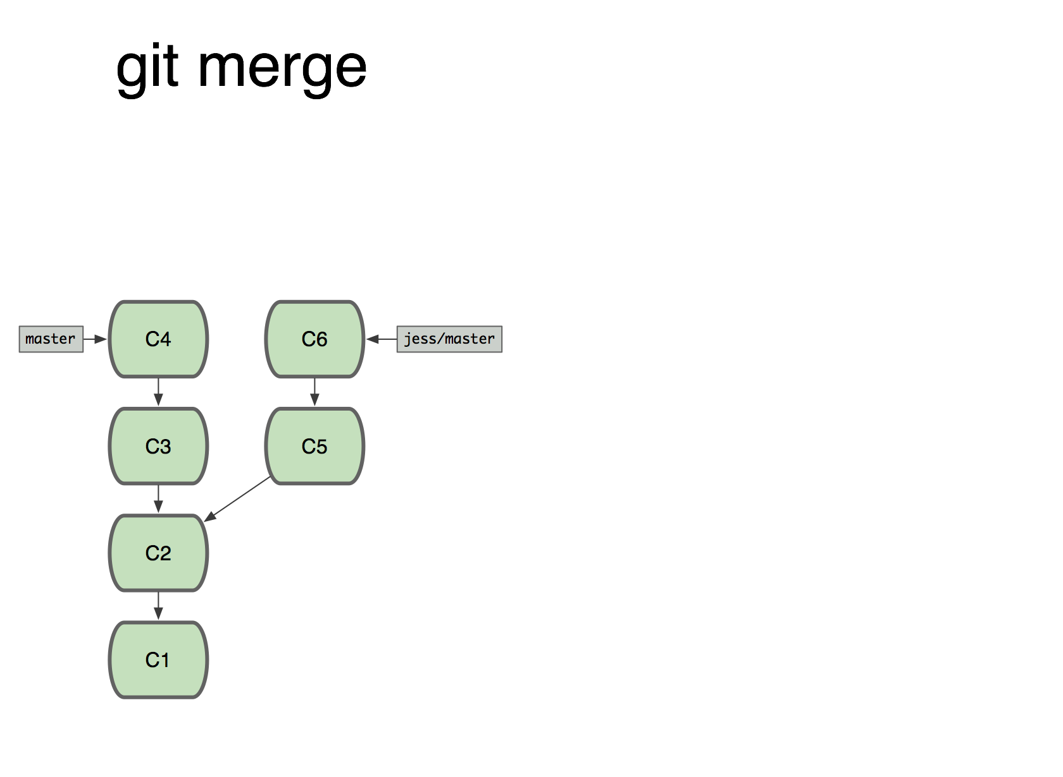
Notes:
say we have this history, where we made two commits, made a new branch jess, made two more commits, checked out master, and made two more commits there as well.

Slide 176
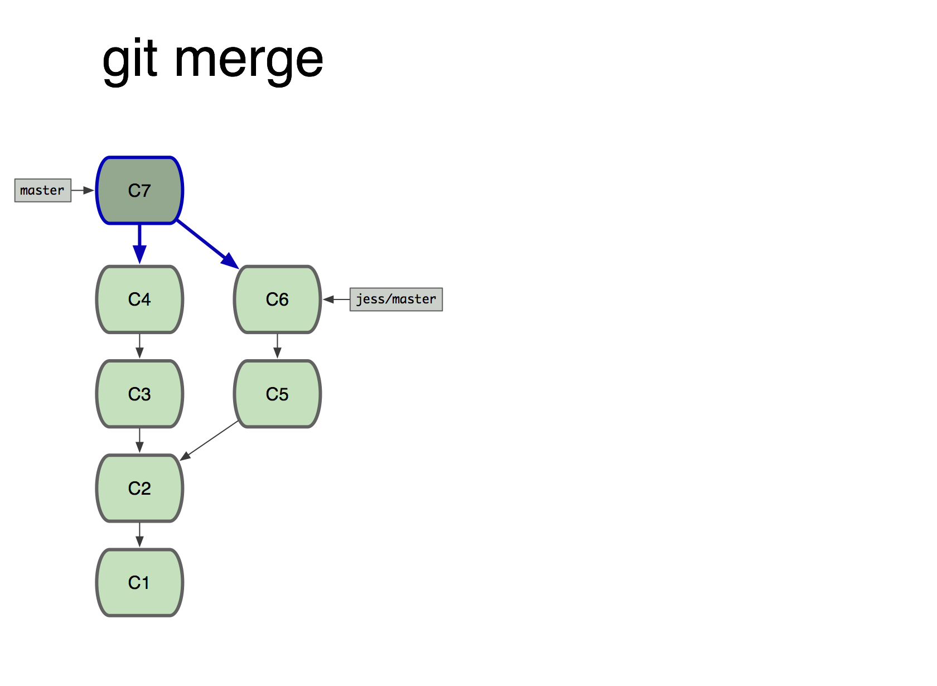
$> git merge jess
Notes:
a merge at this point would create a new commit on master with two parents.

Slide 177
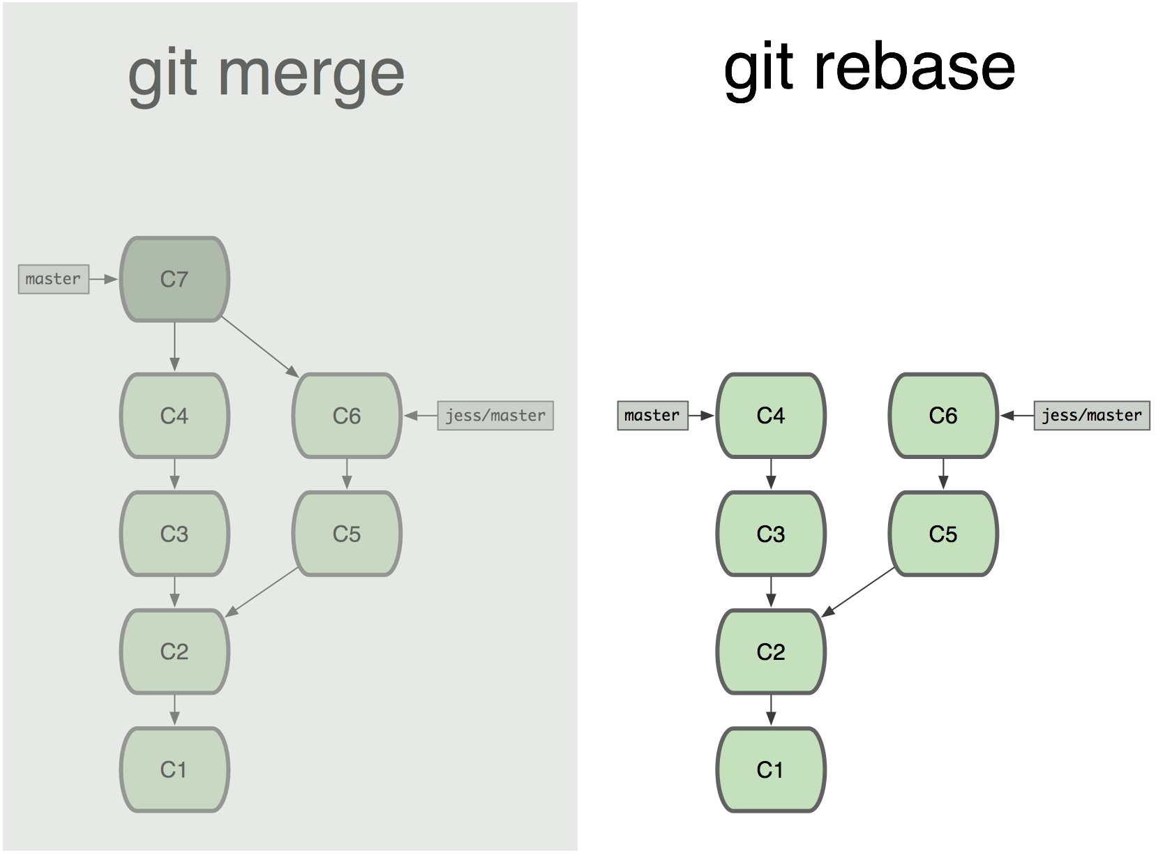
Notes:
here’s what would happen to the same tree if we rebased instead of merging. remember that master is the current branch.

Slide 178
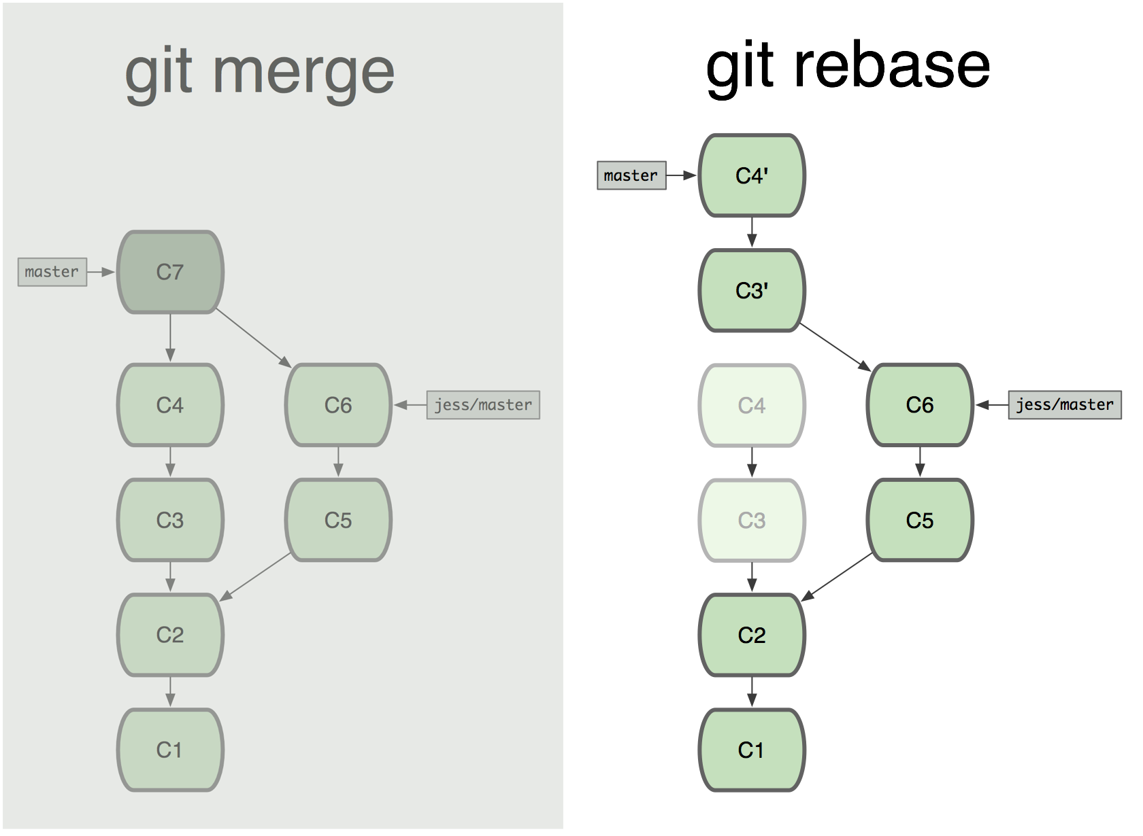

Slide 179
Notes:
it takes all the commits since the two branches diverged

Slide 180
2
1
Notes:
makes each commit into a patchfile

Slide 181
2
1
Notes:
and applies them to the other branch, creating new commits

Slide 182
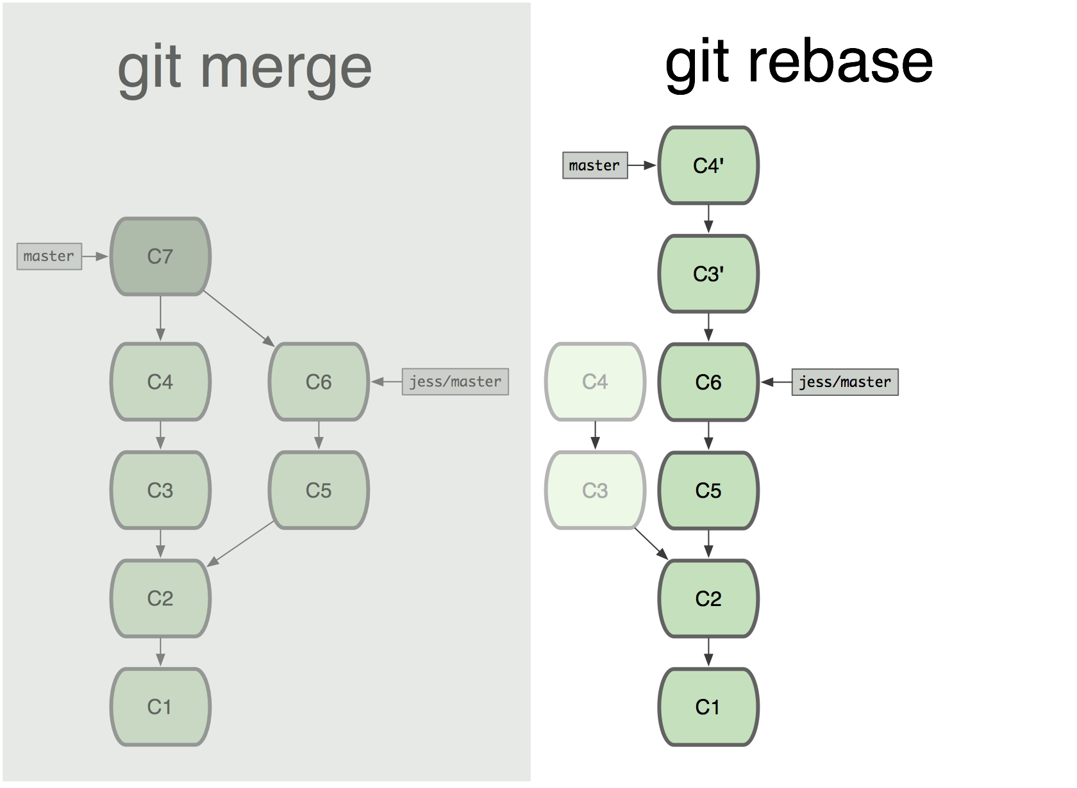

Slide 183
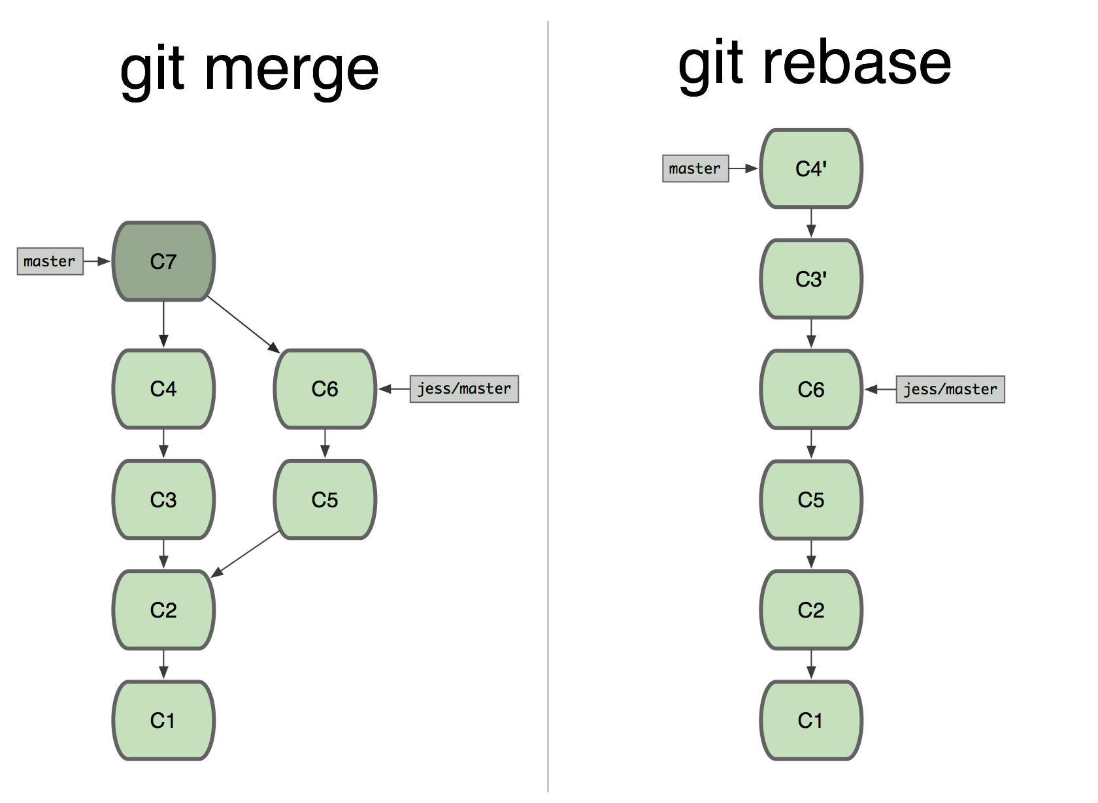
Notes:
so you end up with a linear history that’s easier to follow in the than a branched history. the “true” history can be examined using the reflog, which we’ll discuss a bit more later.
rebasing rewrites the history, so don’t rebase if other people have used your commits. for instance, do not rebase commits that you’ve already pushed to a remote repository!
but again, we’re getting ahead of ourselves again…

Slide 184
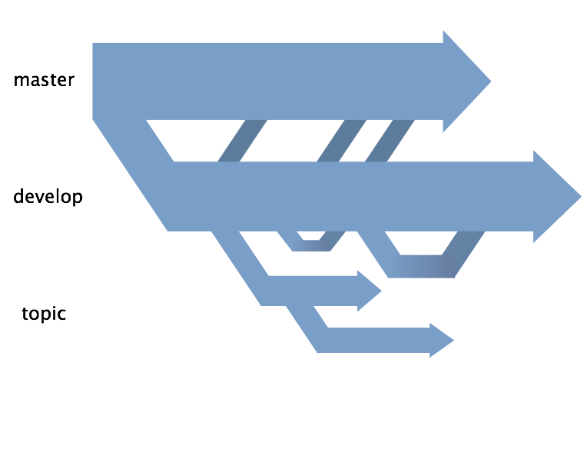
Notes:
first, now that you know how to branch, I’m going to tell you how many successful developers branch
in many open source projects, you’ll almost always see a stable master branch,

Slide 185
Notes:
one or more development branches

Slide 186
Notes:
which regularly

Slide 187
Notes:
get merged back into master when they’re stable

Slide 188
Notes:
and many topic branches

Slide 189
Notes:
which is where most of the individual developer work is done,
and which get merged back into development when they’re complete

Slide 190
“production”
Notes:
master usually represents the production branch,

Slide 191
“production”
“trunk”
Notes:
and development is your trunk

Slide 192
“production”
convention!
“trunk”
Notes:
this is, of course, mere convention, and you don’t have to follow it, but it does make your work easier to understand and discuss,
and you will be more easily able to switch back and forth between topics if you have topic branches to reduce the coupling between unrelated tasks

Slide 193
Understanding Git
The Basics
The Git Object Database
History Inspection
Branching Workflows
Collaboration
Advanced Stuff
Troubleshooting
Notes:
on to Collaboration, and more generally, remotes.
We need to be able to work with other people, but the whole repository is on my laptop so... what?

Slide 194
Collaboration
git remote
git push
git clone
git fetch
git pull
Notes:
our new commands are git remote, push, clone, fetch and pull

Slide 195
Collaboration
git remote
git push
git clone
git fetch
git pull

Slide 196
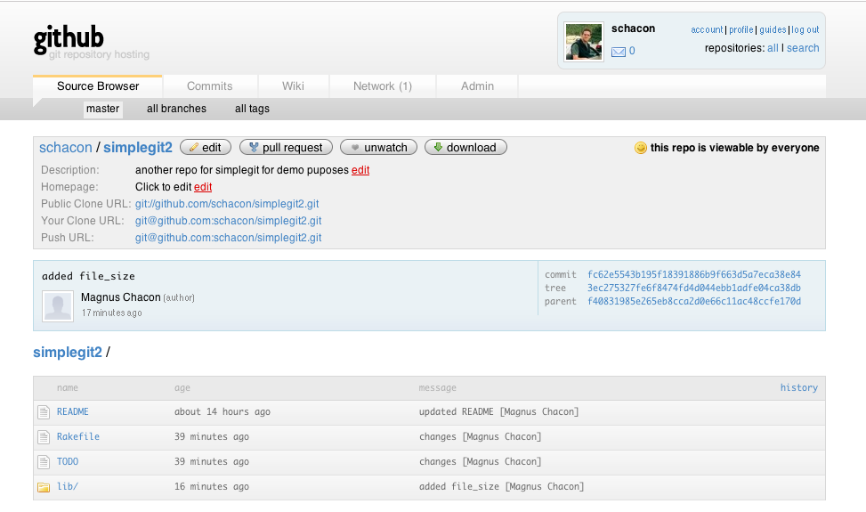
Notes:
say there’s some web-accessible git repository somewhere and you already have a copy of the simplegit2 repo you’ve been working on, and would like to send up what you’ve been working on.

Slide 197
Notes:
you find the url of the remote repository

Slide 198
git@github.com:schacon/simplegit2.git
Notes:
this one uses the ssh protocol, so we can send as well as receive

Slide 199
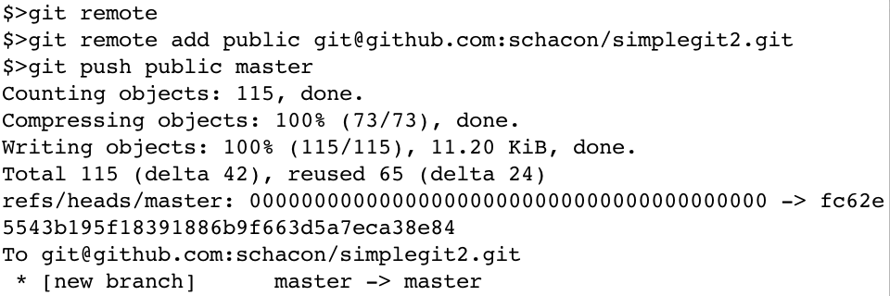
Notes:
we use git remote add to tell git we’d like to add a new remote repo to it’s records

Slide 200
Notes:
we’ll nickname it “public”

Slide 201
Notes:
and give it the url we found on github
now, nothing at all happens when you add a remote, except that git has associated that nickname with that url

Slide 202
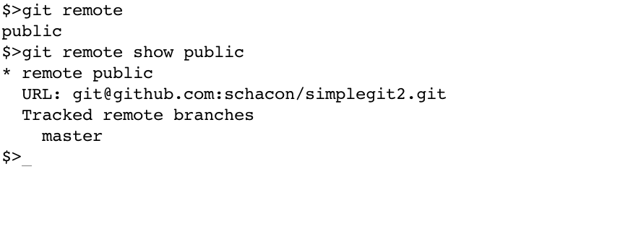
Notes:
but now we can say things like git push

Slide 203
Notes:
public

Slide 204
Notes:
master, which, if our changes are downstream from the remote repo, will send all new commits on our master branch to the remote master branch

Slide 205
Notes:
git remote with no arguments will tell you things about the remotes you have configured

Slide 206
Notes:
and git remote show gives you a bit more detail

Slide 207
Collaboration
git remote
git push
git clone
git fetch
git pull
Notes:
git clone is exactly what it sounds like – it makes an object-for-object clone on your local machine, of a remote repository. it also makes a local branch to track the currently-active remote branch, usually master, and checks it out.

Slide 208
Collaboration
$> git clone git@github.com:danielpcox/Bare-Bones-Platformer.git platformer
Cloning into 'platformer'...
remote: Counting objects: 285, done.
remote: Compressing objects: 100% (197/197), done.
remote: Total 285 (delta 138), reused 221 (delta 74)
Receiving objects: 100% (285/285), 7.46 MiB | 688 KiB/s, done.
Resolving deltas: 100% (138/138), done.
$>
Notes:
here I am cloning a repository I have on github using the ssh protocol and url scheme,

Slide 209
Collaboration
$> git clone git@github.com:danielpcox/Bare-Bones-Platformer.git platformer
Cloning into 'platformer'...
remote: Counting objects: 285, done.
remote: Compressing objects: 100% (197/197), done.
remote: Total 285 (delta 138), reused 221 (delta 74)
Receiving objects: 100% (285/285), 7.46 MiB | 688 KiB/s, done.
Resolving deltas: 100% (138/138), done.
$>
Notes:
and providing an optional renaming.

Slide 210
Collaboration
$> git clone git@github.com:danielpcox/Bare-Bones-Platformer.git platformer
Cloning into 'platformer'...
remote: Counting objects: 285, done.
remote: Compressing objects: 100% (197/197), done.
remote: Total 285 (delta 138), reused 221 (delta 74)
Receiving objects: 100% (285/285), 7.46 MiB | 688 KiB/s, done.
Resolving deltas: 100% (138/138), done.
$> ls platformer
Gemfile
Gemfile.lock
README.md
levels
lib
media
objects
platformer.rb
Notes:
and there are the files

Slide 211
Collaboration
$> git clone git@github.com:danielpcox/Bare-Bones-Platformer.git platformer
Cloning into 'platformer'...
remote: Counting objects: 285, done.
remote: Compressing objects: 100% (197/197), done.
remote: Total 285 (delta 138), reused 221 (delta 74)
Receiving objects: 100% (285/285), 7.46 MiB | 688 KiB/s, done.
Resolving deltas: 100% (138/138), done.
$> ls platformer
Gemfile
Gemfile.lock
README.md
levels
lib
media
objects
platformer.rb
Notes:
as an aside, this is another case besides garbage-collection in which git will generate a pack file of your objects,
it’s necessary here so that an entire repository can be more efficiently transmitted

Slide 212
Collaboration
$> git clone git@github.com:danielpcox/Bare-Bones-Platformer.git platformer
Cloning into 'platformer'...
remote: Counting objects: 285, done.
remote: Compressing objects: 100% (197/197), done.
remote: Total 285 (delta 138), reused 221 (delta 74)
Receiving objects: 100% (285/285), 7.46 MiB | 688 KiB/s, done.
Resolving deltas: 100% (138/138), done.
$> git branch
* master
Notes:
here’s that tracking branch I mentioned, which is at the same place master is, in the remote repo

Slide 213
Collaboration
git remote
git push
git clone
git fetch
git pull
Notes:
fetch is the opposite of push
it downloads any commits you don't already have from some branch of the remote repository into a not-that-hidden branch of your repository.
No merging is done, but the commits are available for you to look at.

Slide 214
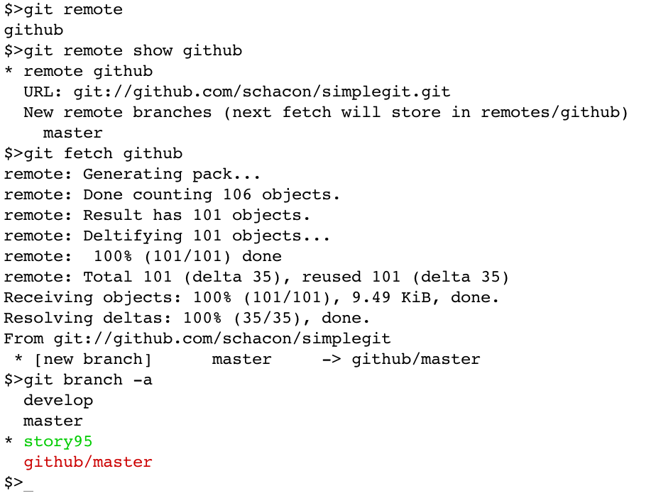
Notes:
say we have a repository with a remote configured

Slide 215
Notes:
simplegit again

Slide 216
Notes:
I can see that this remote is using the GIT protocol, so I can’t push, but I can fetch

Slide 217
Notes:
notice that we’ve downloaded the upstream commits from the remote master not onto our master but onto another local branch, called github/master

Slide 218
Notes:
which you can see using –a on git branch.
now, this is an important point – remotes aren’t anything new to the git data model

Slide 219
…
└── refs
├── heads
│ └── master
├── remotes
│ └── origin
| ├── master
│ └── HEAD
└── …
.git/refs/remotes/nickname/branchname
Notes:
they are simply branches, and appear underneath .git/refs/remotes/nickname/branchname

Slide 220
Notes:
now this branch can be used in every way like a normal local branch, except that it cannot be checked out.
you can merge from it, rebase onto it, cherry-pick from it, browse its logs… etc.

Slide 221
Collaboration
git remote
git push
git clone
git fetch
git pull
Notes:
git pull
this one will be easy
a pull is not the opposite of a push.

Slide 222
Collaboration
pull = fetch + merge
Notes:
the default behavior of a pull is a fetch, followed by a merge
since I’ve talked about both of those, I won’t spend any more time on it

Slide 223
Collaboration
git remote
git push
git clone
git fetch
git pull
Notes:
those are the commands…

Slide 224
remote workflow
Notes:
here are some practical examples

Slide 225
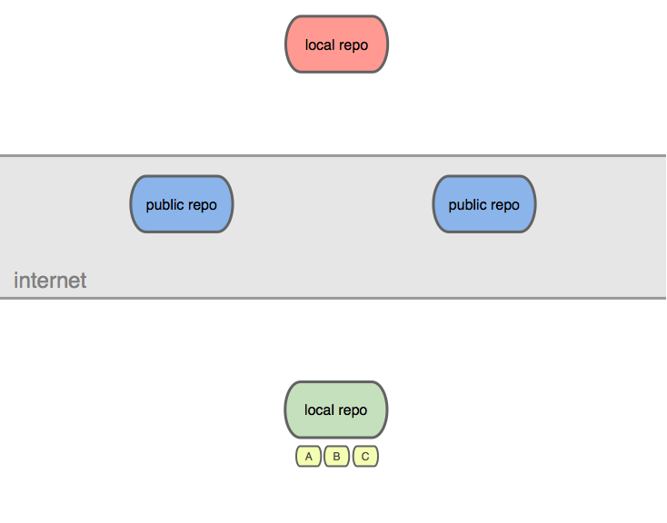
Notes:
say we have this setup, and in our local repo, a bunch of commits.

Slide 226
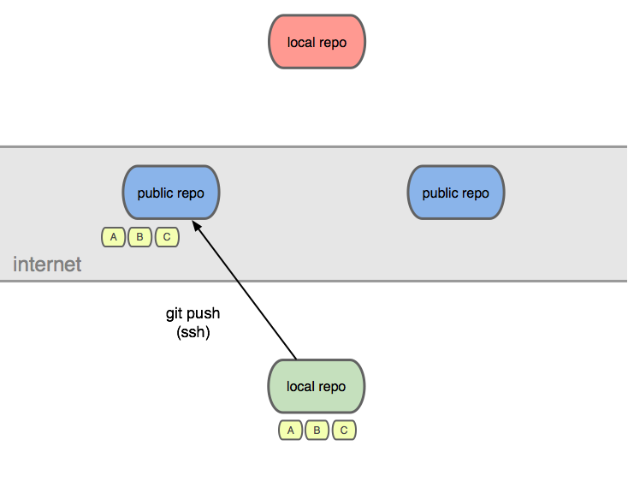
Notes:
we can git push over ssh to a public repo we control

Slide 227
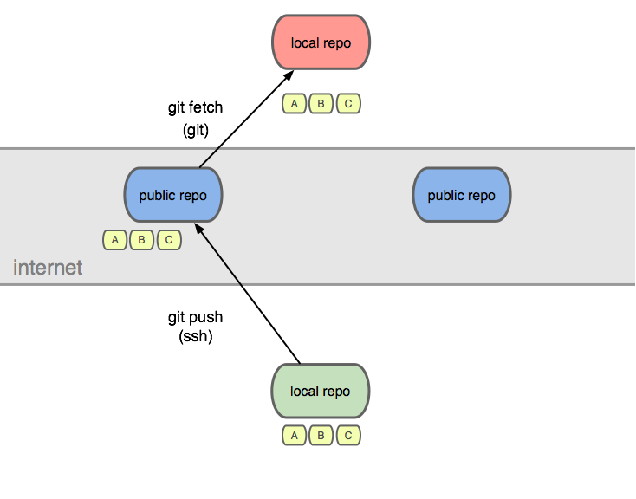
Notes:
so someone else can git fetch from it to get our commits

Slide 228
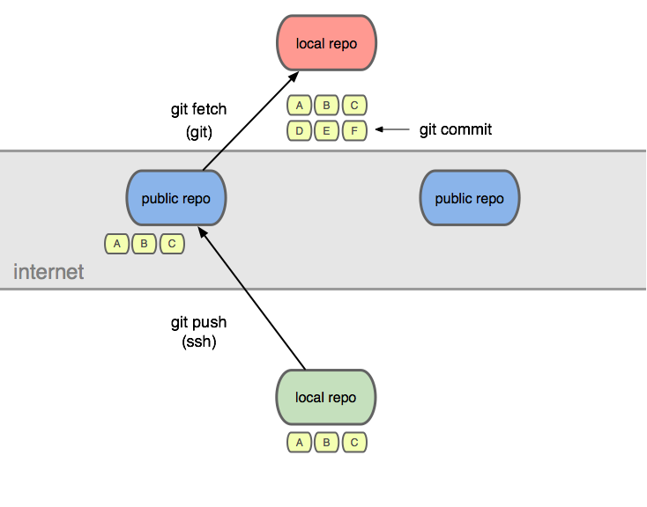
Notes:
they may add their own,

Slide 229
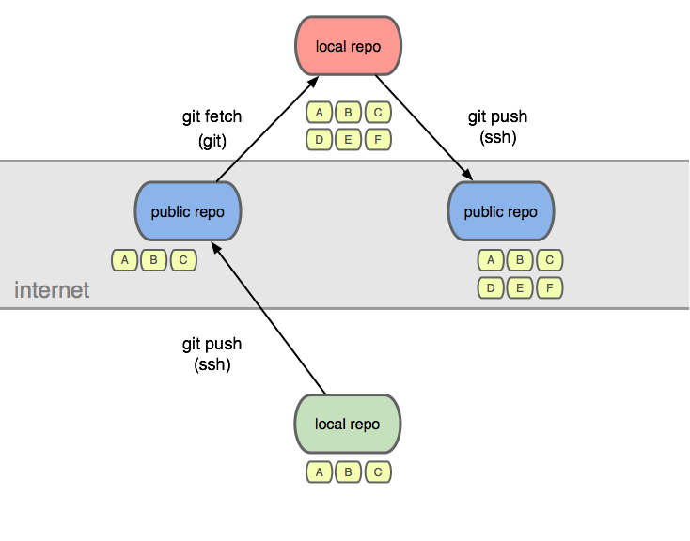
Notes:
and push to their own public repo

Slide 230
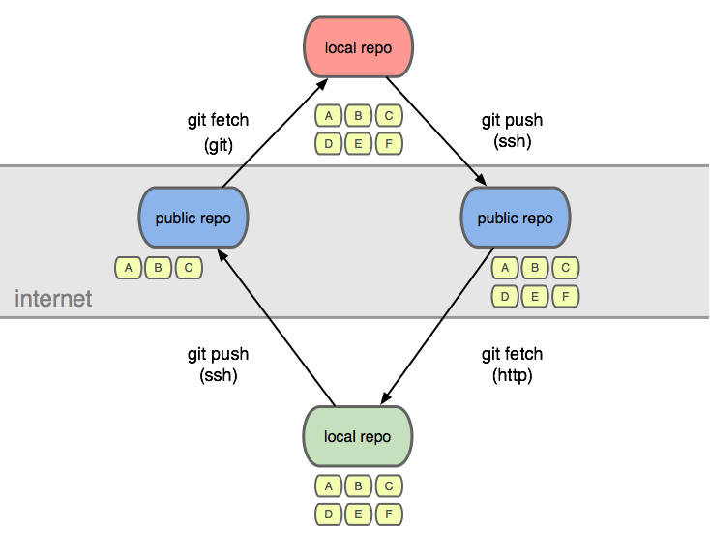
Notes:
which we can fetch from to get (notice) only their three new commits.

Slide 231
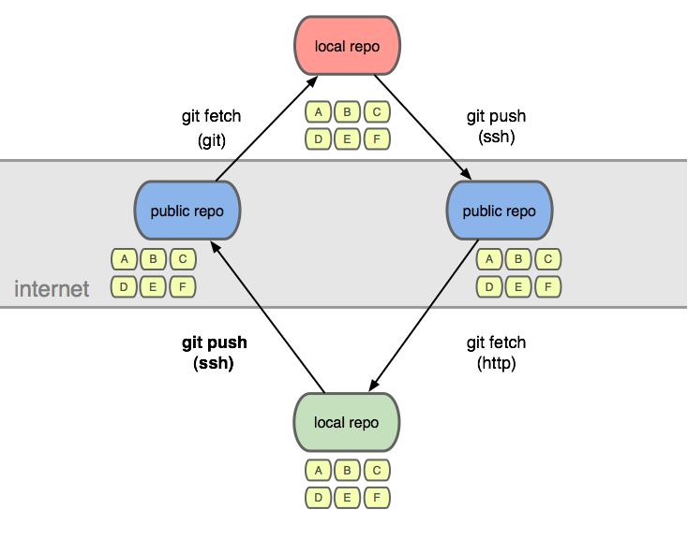
Notes:
which we can send to our repo if we like

Slide 232
multiple remotes

Slide 233
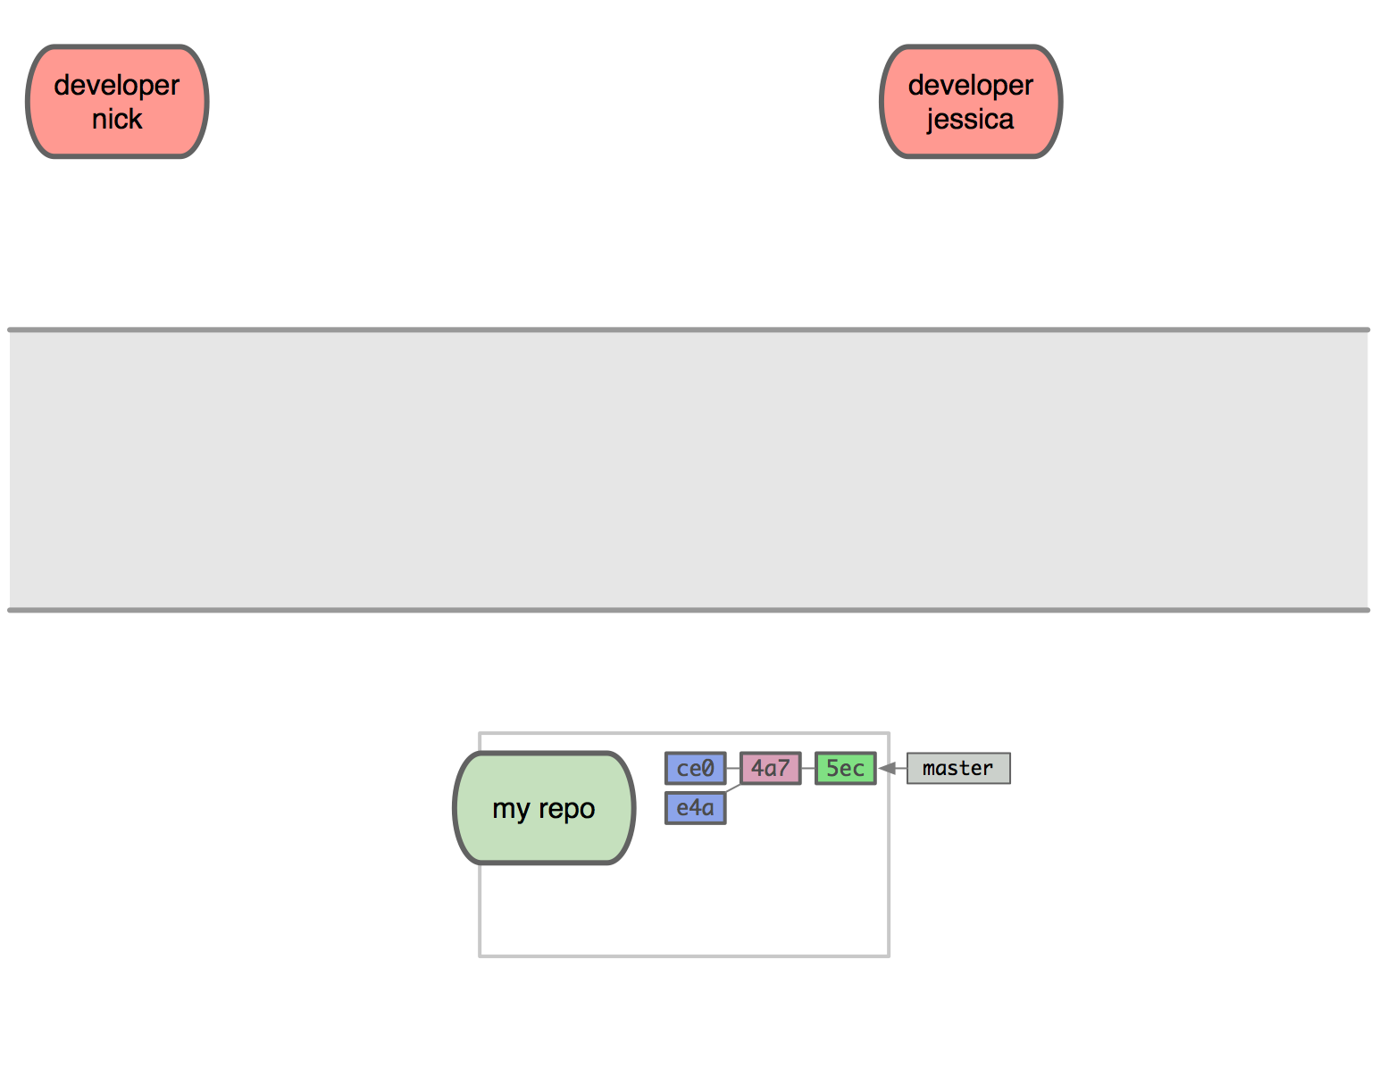
Notes:
this one’s a bit more complicated
this is the github model, and is quite social

Slide 234
commit
Notes:
commit

Slide 235
tree
Notes:
tree

Slide 236
blobs
Notes:
blobs

Slide 237
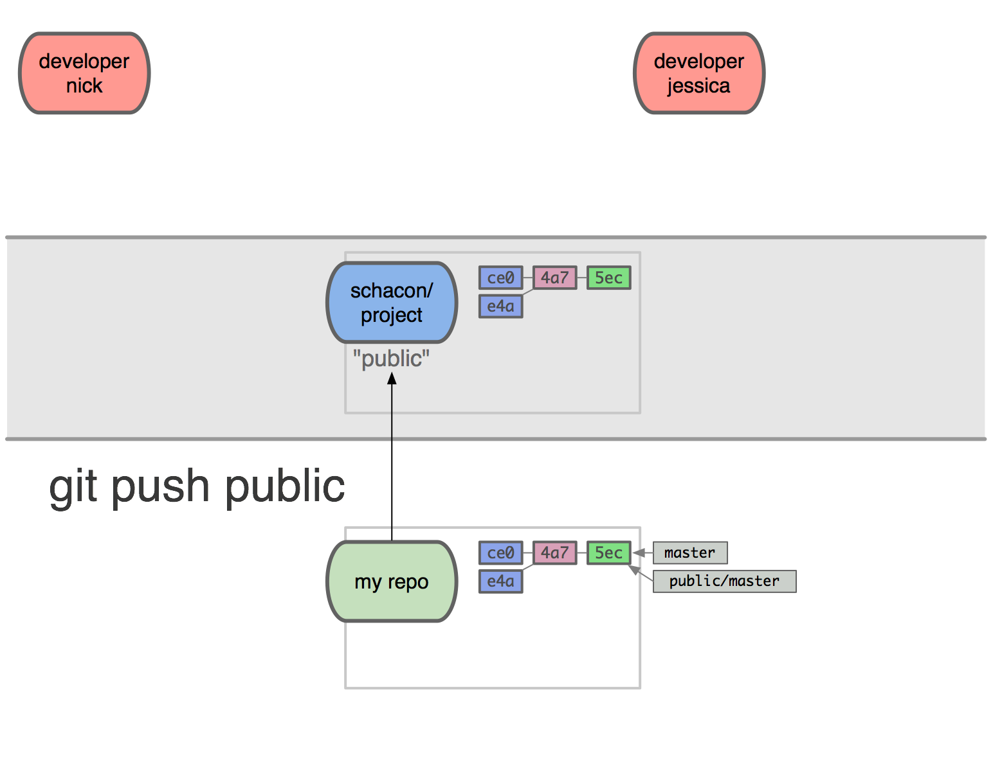
Notes:
i have a public project I’m working on, and that remote is nicknamed “public”
so I push my commit tree there

Slide 238
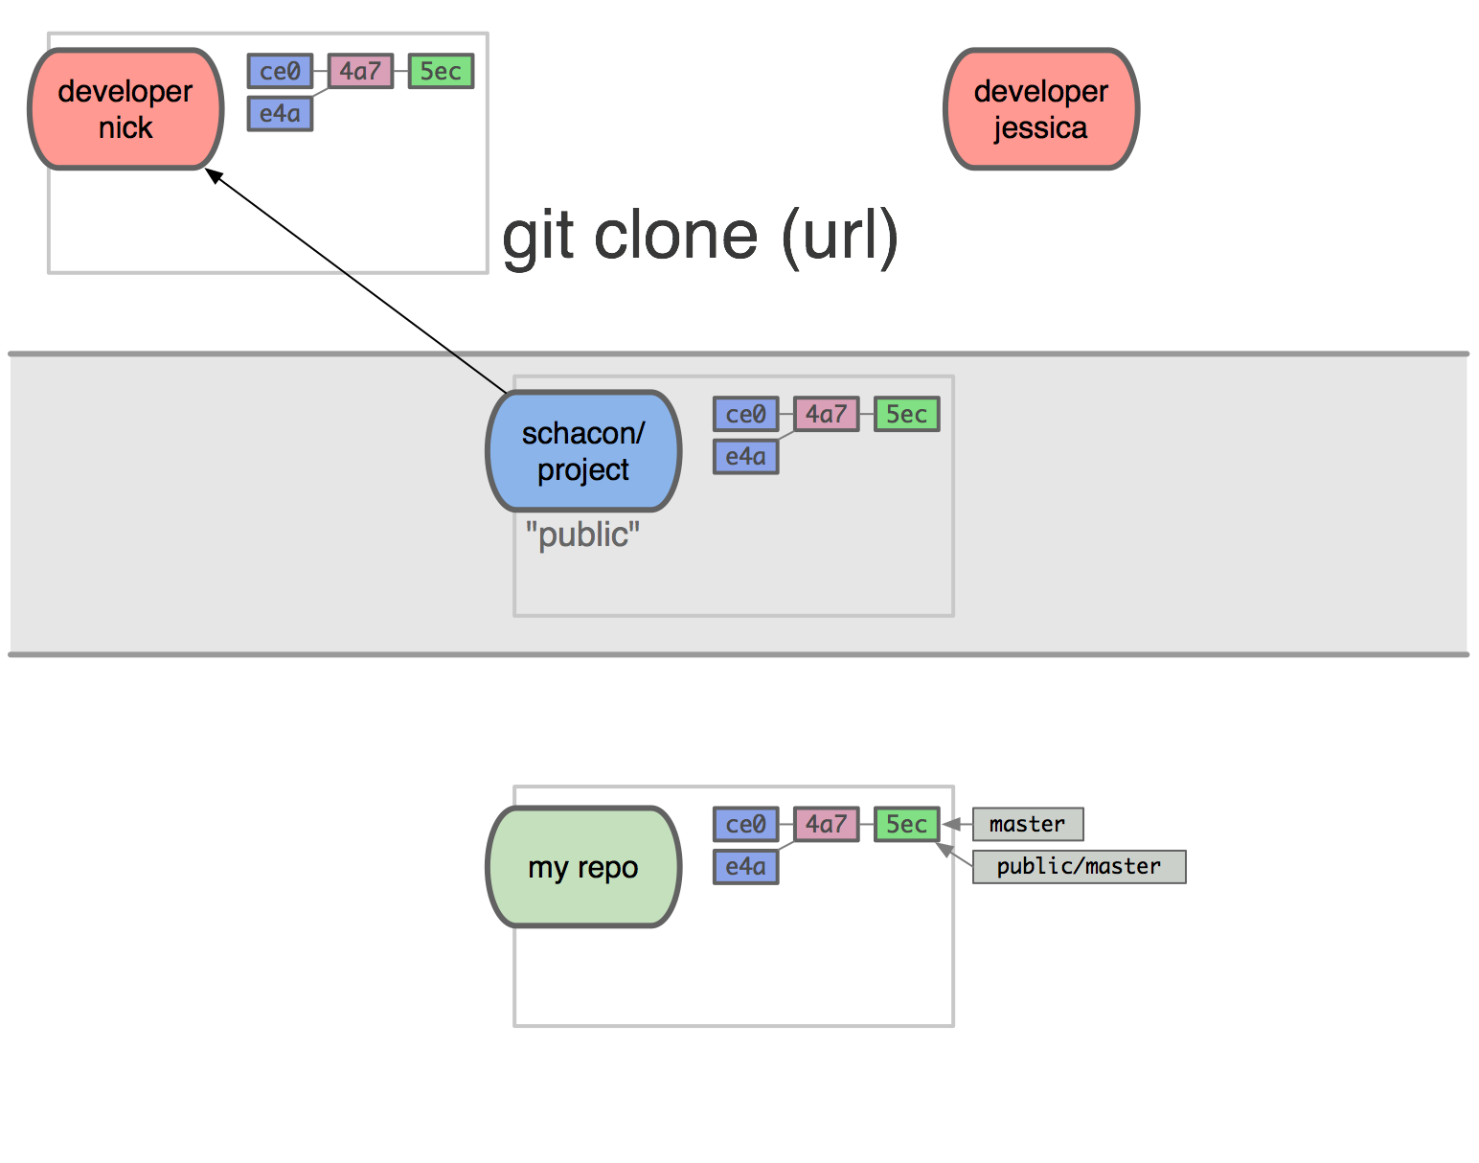
Notes:
nick clones

Slide 239
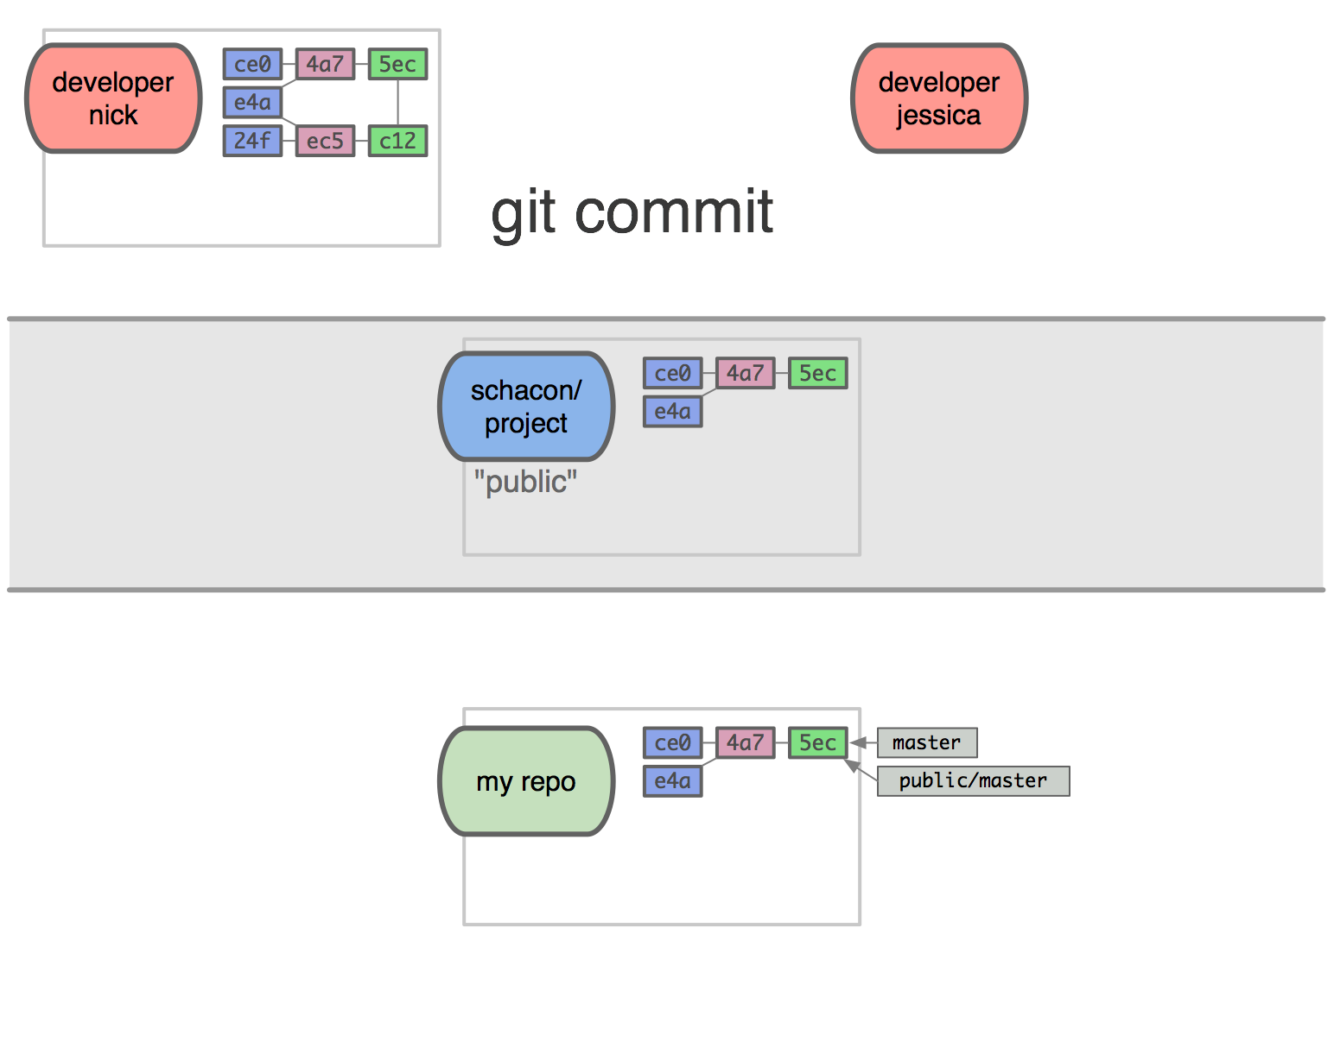
Notes:
and does some work

Slide 240
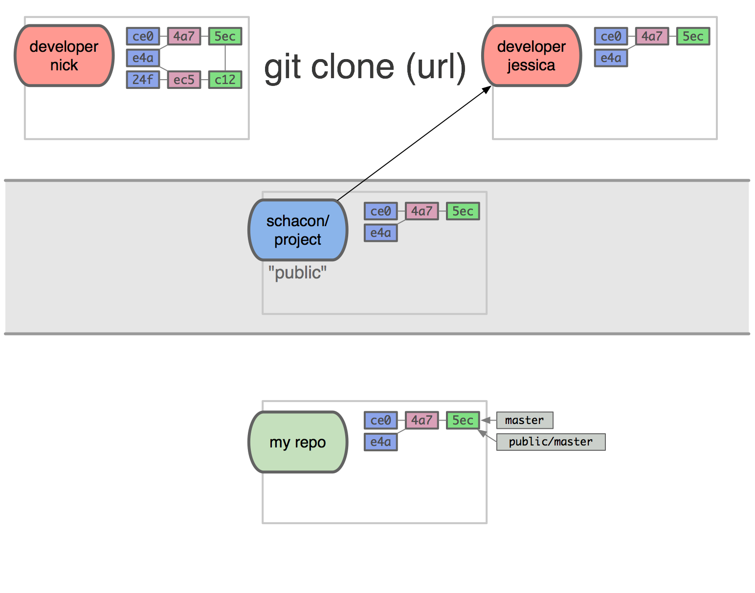
Notes:
jessica clones

Slide 241
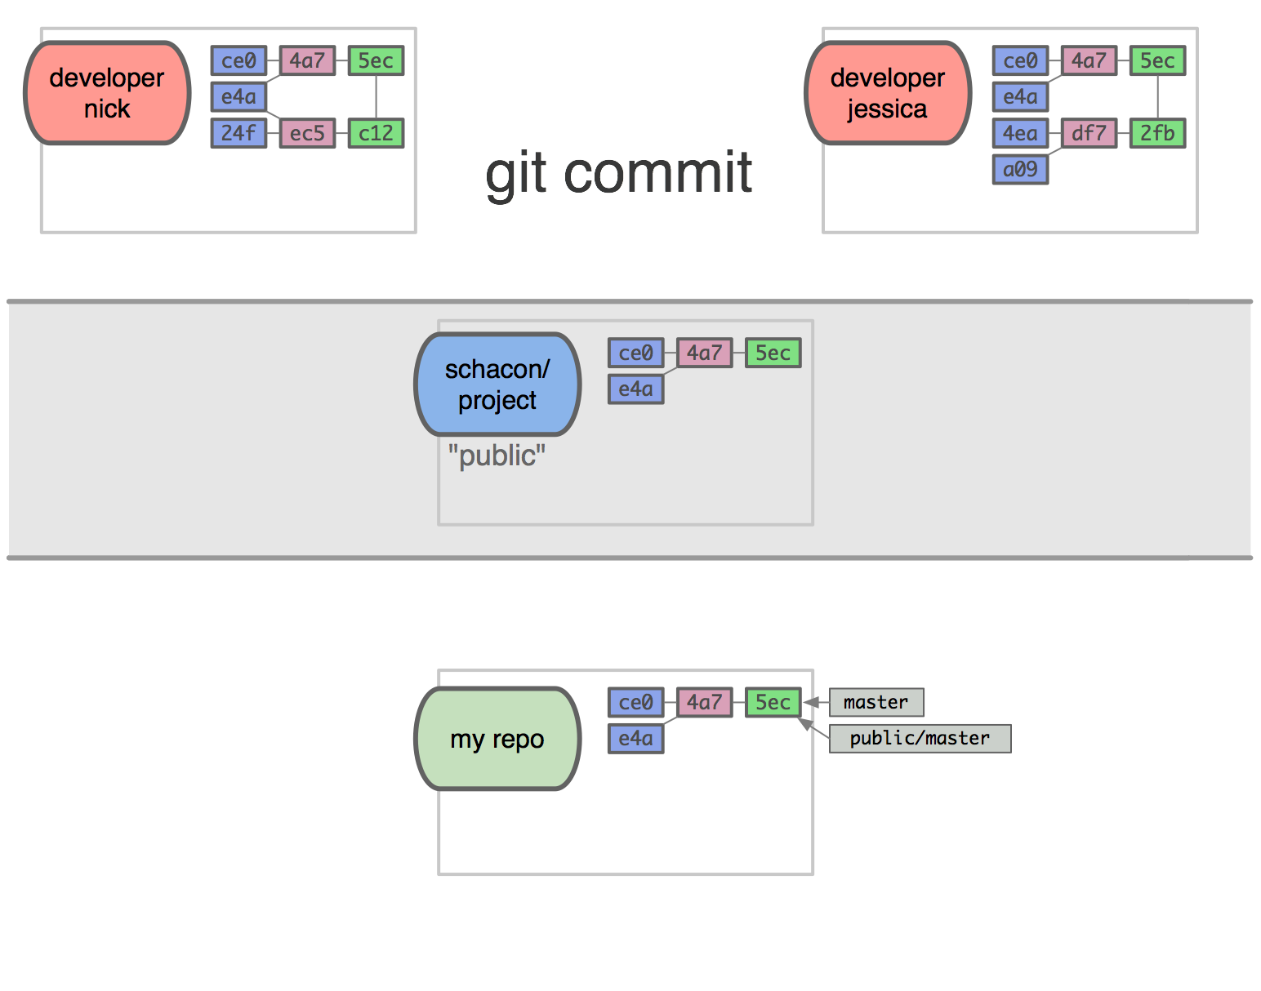
Notes:
and does some unrelated work

Slide 242
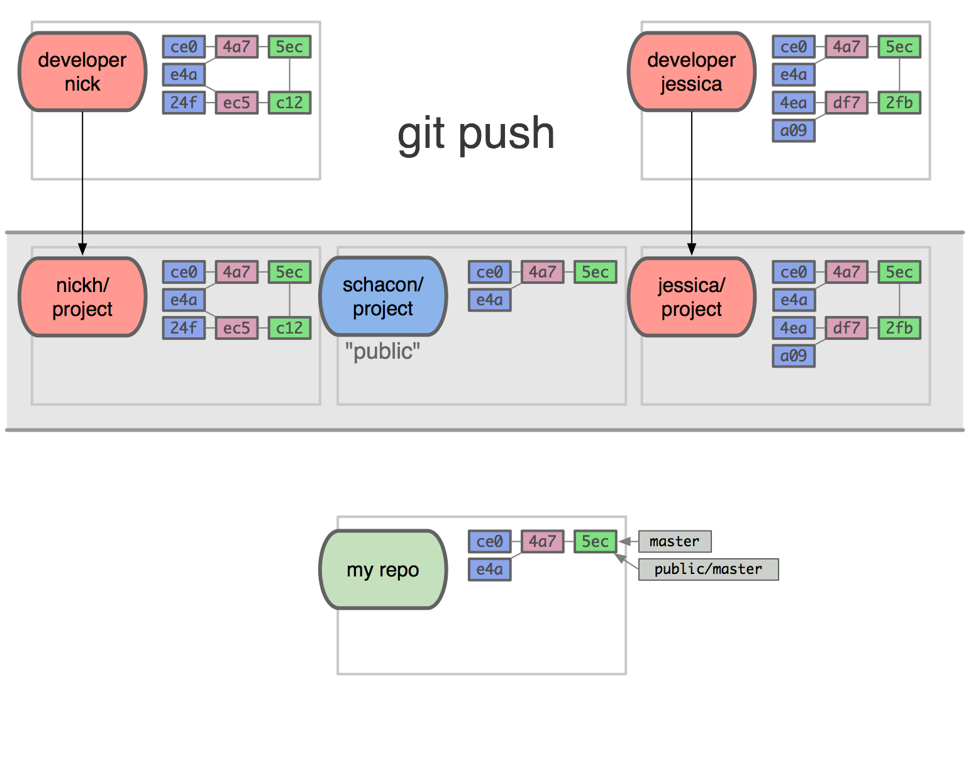
Notes:
they both push to their own public repositories

Slide 243
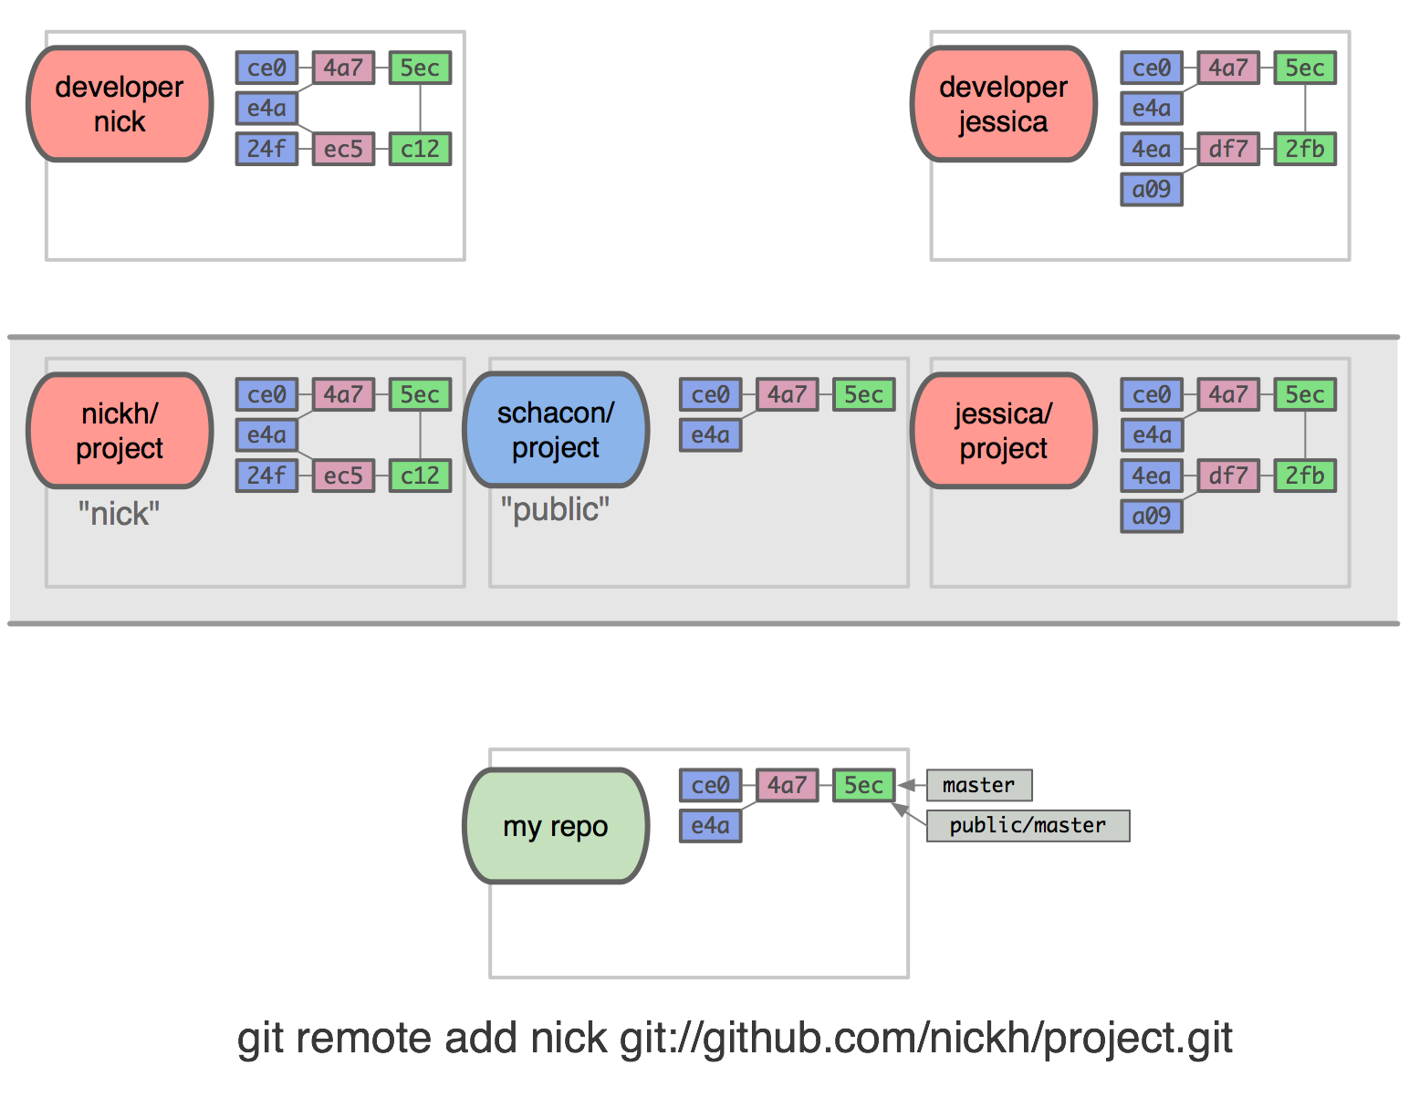
git remote add nick git://github.com/nickh/project.git
Notes:
now, I’m interested in their work because it’s based on mine and perhaps they asked me to merge it into the main project…
so I need to be able to access it in my local repo

Slide 244
“nick”
git remote add nick git://github.com/nickh/project.git
Notes:
so I nickname nick’s public repo url “nick”

Slide 245
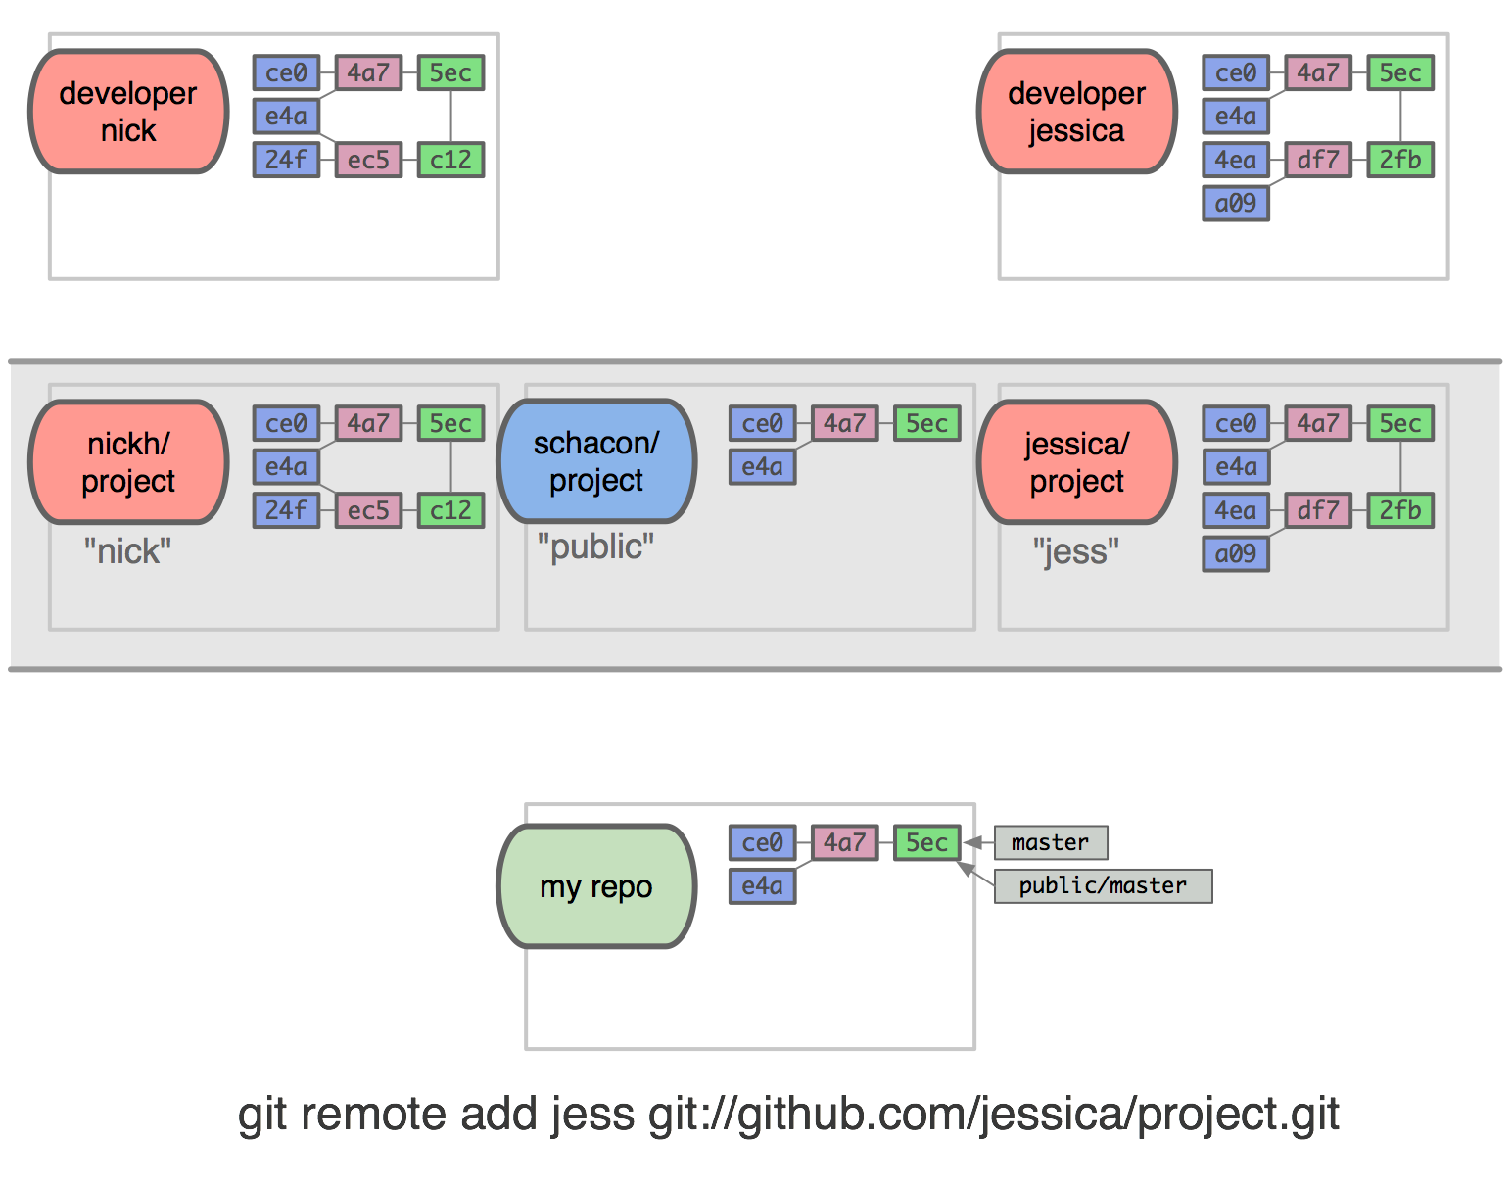
git remote add jess git://github.com/jessica/project.git
Notes:
and jessica’s

Slide 246
“jess”
git remote add jess git://github.com/jessica/project.git
Notes:
“jess”

Slide 247
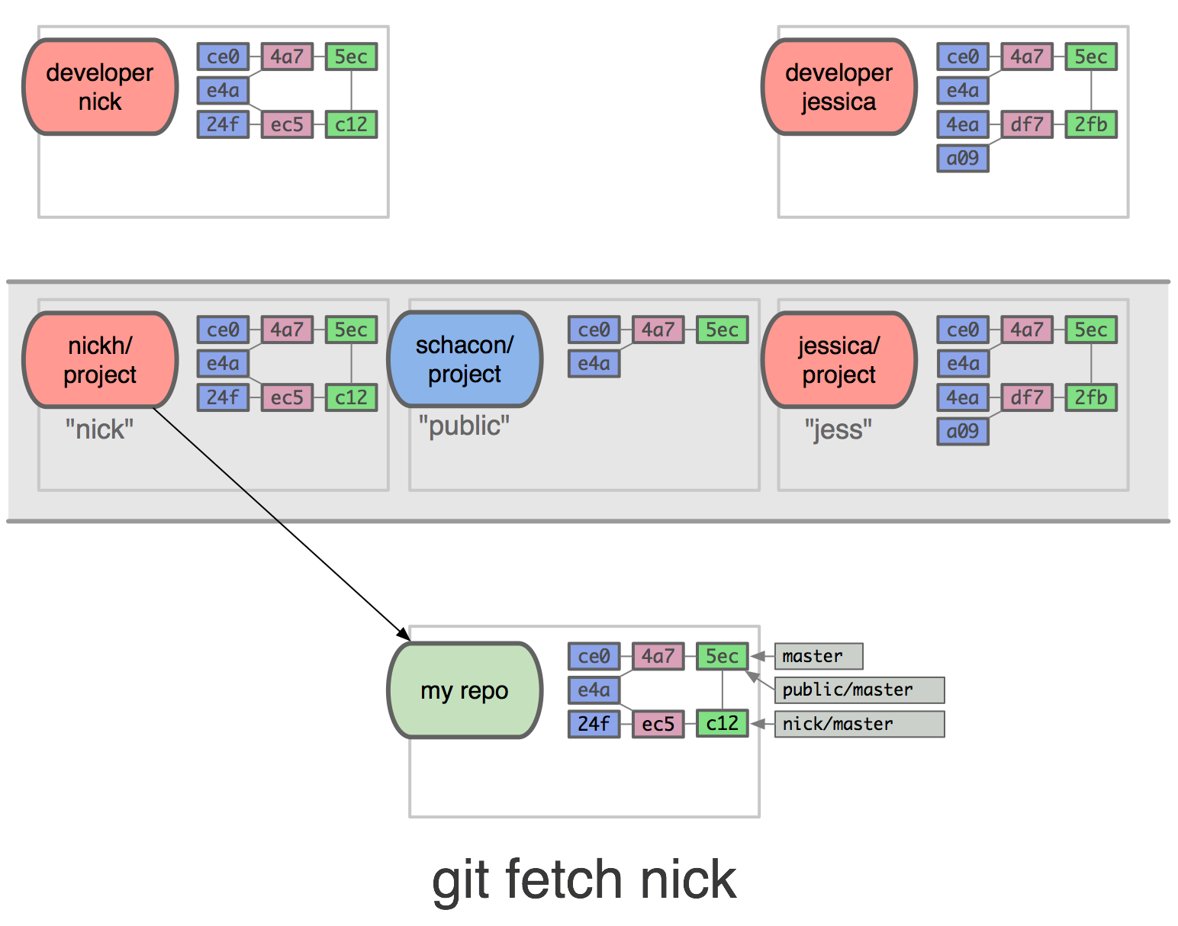
git fetch nick
Notes:
and now I can do cool things like git fetch nick

Slide 249
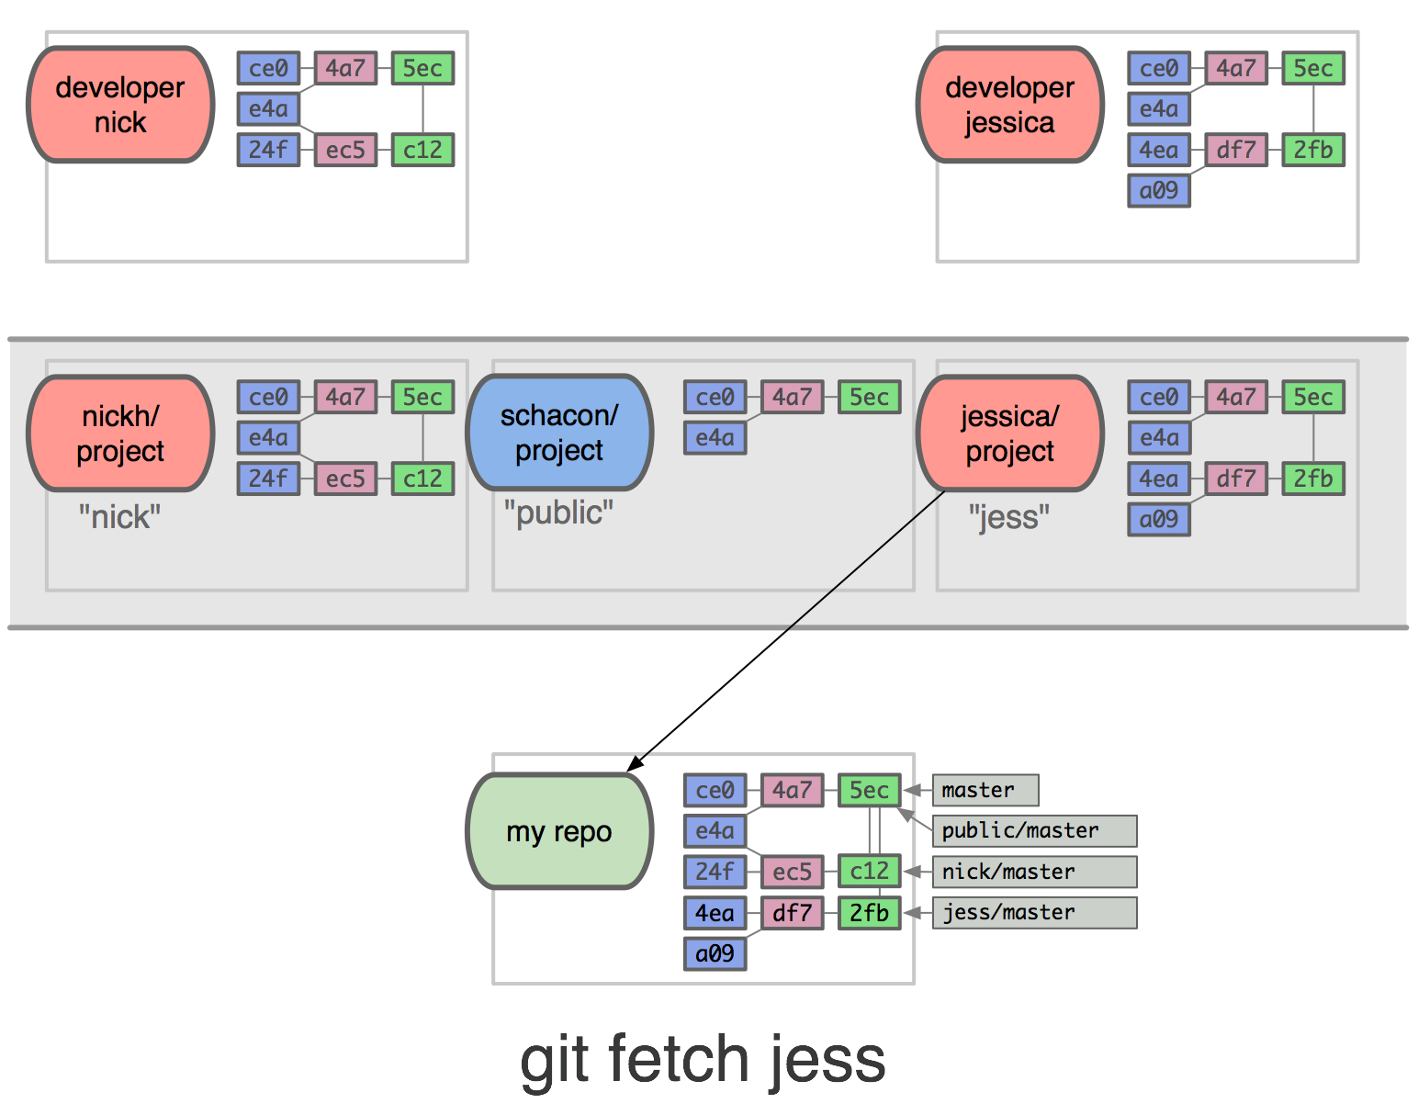
git fetch jess
Notes:
and git fetch jess

Slide 250
Notes:
to get their work for inspection

Slide 251
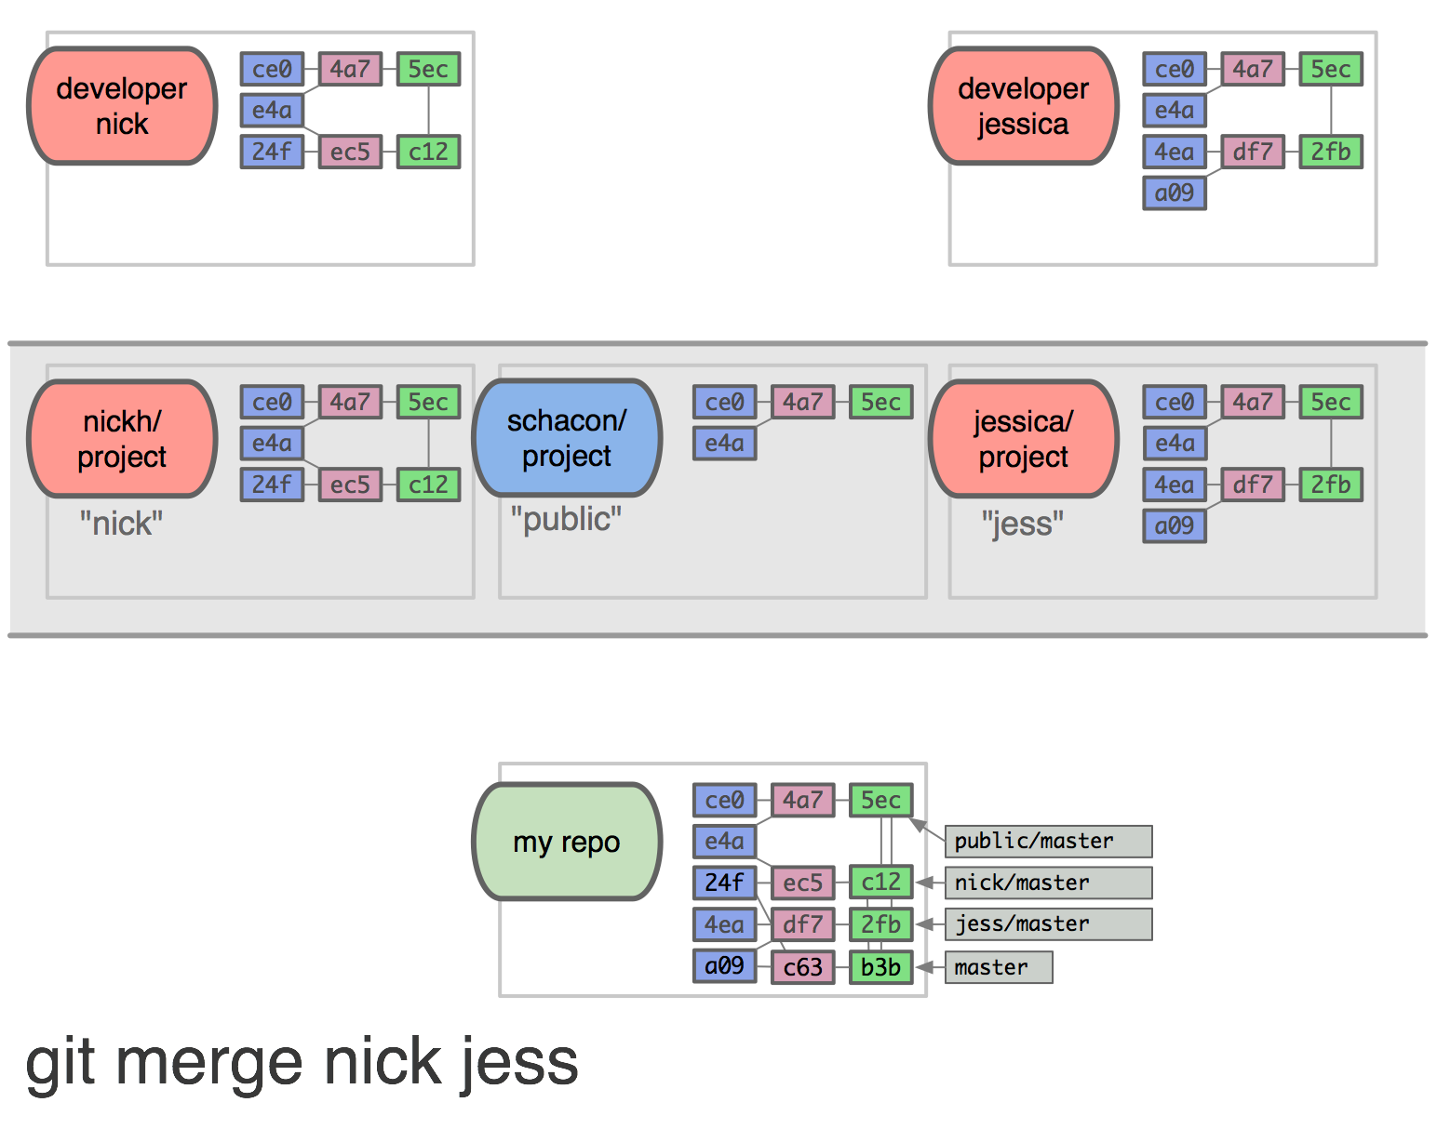
Notes:
I like it all, so I do a fancy three-way merge

Slide 252
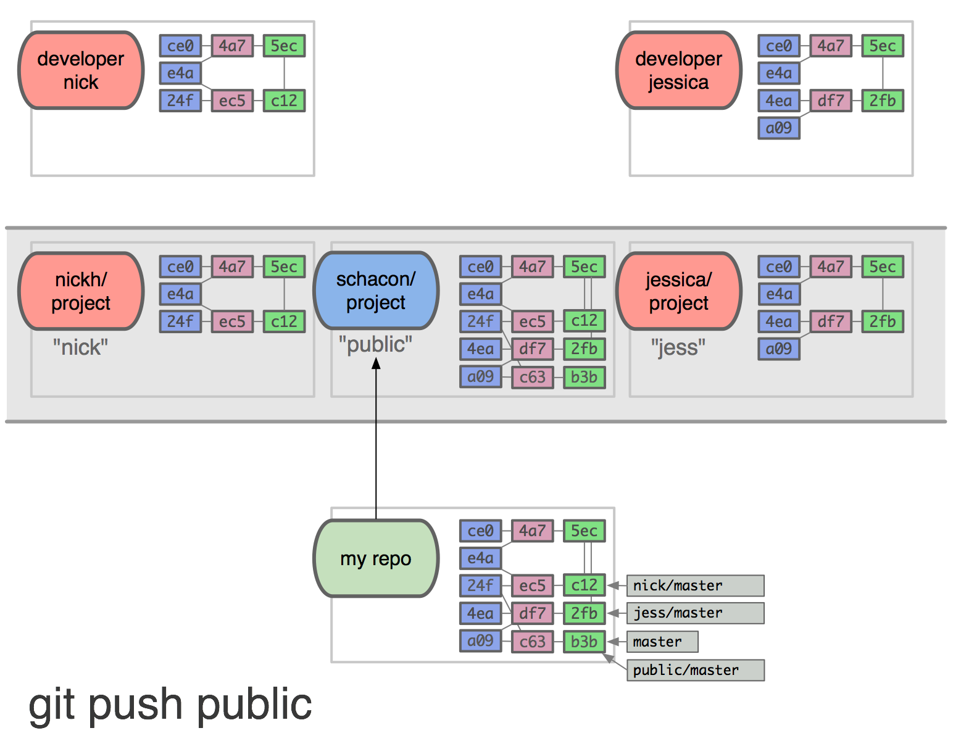
Notes:
and push everything up to my public repository for the whole world to use

Slide 253
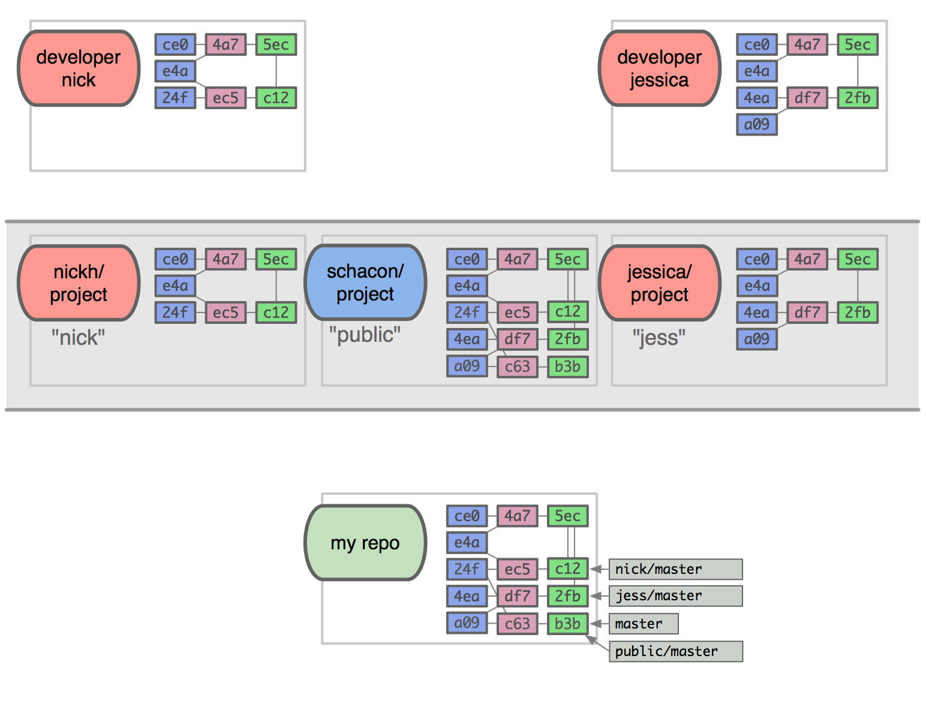
Notes:
that had to be pretty fast, but notice the propagation of objects

Slide 254
Notes:
nick’s

Slide 255
Notes:
jessica’s

Slide 256
Notes:
and my merge objects

Slide 257
Understanding Git
The Basics
The Git Object Database
History Inspection
Branching Workflows
Collaboration
Advanced Stuff
Troubleshooting
Notes:
that wraps collaboration

Slide 258
Advanced Stuff
the index
hook scripts
grab-bag of useful things
git add --interactive and patch adding
git stash [--keep-index] to tuck things away for a second
git cherry-pick to pluck just a few cool things someone else did out of one of their commits
git fsck [--unreachable] as the final defense against lost stuff
git reflog to see the true history
git bisect to find out when an error was introduced
Notes:
on to advanced stuff, starting with…

Slide 259

The Index
Notes:
the index
until now, I have failed to discuss one of the most interesting and misunderstood features of git

Slide 260
The Index
.git
├── COMMIT_EDITMSG
├── HEAD
├── config
├── description
├── hooks
│ ├── …
├── index
├── info
│ └── exclude
├── logs
│ ├── …
├── objects
│ ├── …
└── refs
├── heads
│ └── master
└── tags
└── taggy
15 directories, 22 files
Notes:
you remember the .git directory

Slide 261
The Index
.git
├── COMMIT_EDITMSG
├── HEAD
├── config
├── description
├── hooks
│ ├── …
├── index
├── info
│ └── exclude
├── logs
│ ├── …
├── objects
│ ├── …
└── refs
├── heads
│ └── master
└── tags
└── taggy
15 directories, 22 files
← there it is
Notes:
well, there’s the index

Slide 262

index
Notes:
the index is a cache that sits in-between your ever-changing working directory, and your permanent repository

Slide 263
index
Notes:
when you run ‘git add’ on files, it caches the snapshot of those versions of the files in the index

Slide 264
index
Notes:
then when you run ‘git commit’, it actually writes the commit object pointing not to the versions of the files in your working directory, but what they looked like when you ‘git added’ them

Slide 265
what?

Slide 266

Notes:
imagine we have some repository, and its state is laid out here

Slide 267
Notes:
on the far left we have the git object database, which currently contains two commits, one tree and two blobs

Slide 268
Notes:
on the far right our working directory,

Slide 269
Notes:
and in the middle the index.

Slide 270
git checkout
Notes:
we then checkout master,

Slide 271

git checkout
Notes:
which populates the index with

Slide 272
git checkout
Notes:
the SHAs of the files as they appear in the object database,

Slide 273
git checkout
Notes:
the SHAs of the same files as they are in the “staging area”,

Slide 274
git checkout
Notes:
and the SHAs as they are in the working directory.
(and by the way, the SHAs are always 40 characters, but I use just three here to save space)

Slide 275
git checkout
Notes:
it also keeps track of the modified time

Slide 276
git checkout
Notes:
and the filenames, which both match those in the working directory.

Slide 277

vim file2
Notes:
now say we edit file2, which changes the mtime

Slide 278

git status
Notes:
when git status is run, the index is updated with file2’s new SHA and mtime under the working dir column

Slide 279
git status
Notes:
because the “staged” SHA for this file differs from the working dir SHA,

Slide 280

git status
Notes:
git knows to tell you that you have a file that has been “changed but not updated”

Slide 282

git add file2
Notes:
now let’s “add” that changed file to the staging area
people usually just say that the file is “added to the index”, or “staged”

Slide 283
git add file2
Notes:
notice that after an add, the staged SHA for the file matches the working dir SHA, which is still different from the object directory’s SHA because the file hasn’t been committed

Slide 284
git add file2
Notes:
however, a dangling blob of that file’s current state has been added to the object database before any commit

Slide 285
git status
Notes:
now if you run git status,

Slide 286

git status
Notes:
git knows that the file is staged to be committed.

Slide 287

git commit
Notes:
so when you run git commit

Slide 288
git commit
Notes:
it updates the index appropriately,

Slide 289
git commit
Notes:
writes the new commit in the object database, the new tree containing one old file blob and the one new file blob that was stashed there earlier,

Slide 290
git commit
Notes:
and moves the branch forward to the new commit.

Slide 291

vim file1 file2
git status
Notes:
one more time.
we edit both files again, and run git status.

Slide 292
vim file1 file2
git status
Notes:
the mtimes are both different,

Slide 293
vim file1 file2
git status
Notes:
so git knows to update working dir SHAs.

Slide 294

git add file1
Notes:
this time we’ll only git-add file1,

Slide 295
git add file1
Notes:
which updates only its staging column in the index to match the working dir,

Slide 296
git add file1
Notes:
and not that of file2.

Slide 297
git status
Notes:
so when we run git status

Slide 298

git status
Notes:
git tells us the right thing about both files, based on the differences between the relevant columns in the index.
file1 is a change to be committed,

Slide 299
git status
Notes:
and file2 is changed but not updated.

Slide 300

git commit
Notes:
and of course, when we then commit,

Slide 301
git commit
Notes:
the index is updated and the object dir receives a new commit and a new tree with the new file1 blob, and the master branch is advanced.

Slide 303
Advanced Stuff
the index
hook scripts
grab-bag of useful things
git add --interactive and patch adding
git stash [--keep-index] to tuck things away for a second
git cherry-pick to pluck just a few cool things someone else did out of one of their commits
git fsck [--unreachable] as the final defense against lost stuff
git reflog to see the true history
git bisect to find out when an error was introduced
Notes:
On to hook scripts.
This will take about thirty seconds, since you all either do some bash scripting or that would have to be its own talk anyway…

Slide 304
Hook Scripts
.git
├── HEAD
├── config
├── description
├── hooks
│ ├── applypatch-msg.sample
│ ├── commit-msg.sample
│ ├── post-update.sample
│ ├── pre-applypatch.sample
│ ├── pre-commit.sample
│ ├── pre-rebase.sample
│ ├── prepare-commit-msg.sample
│ └── update.sample
├── info
│ └── exclude
├── objects
│ ├── info
│ └── pack
└── refs
├── heads
└── tags
8 directories, 12 files
Notes:
when you init a new git repository in the more recent versions of git,

Slide 305
Hook Scripts
.git
├── HEAD
├── config
├── description
├── hooks
│ ├── applypatch-msg.sample
│ ├── commit-msg.sample
│ ├── post-update.sample
│ ├── pre-applypatch.sample
│ ├── pre-commit.sample
│ ├── pre-rebase.sample
│ ├── prepare-commit-msg.sample
│ └── update.sample
├── info
│ └── exclude
├── objects
│ ├── info
│ └── pack
└── refs
├── heads
└── tags
8 directories, 12 files
Notes:
it always creates a few sample hook scripts for you, in the “hooks” directory.

Slide 306
Hook Scripts
.git/hooks/pre-commit.sample :
#!/bin/sh
#
# An example hook script to verify what is about to be committed.
# Called by "git commit" with no arguments. The hook should
# exit with non-zero status after issuing an appropriate message if
# it wants to stop the commit.
#
# To enable this hook, rename this file to "pre-commit".
if git rev-parse --verify HEAD >/dev/null 2>&1
then
against=HEAD
else
# Initial commit: diff against an empty tree object
against=4b825dc642cb6eb9a060e54bf8d69288fbee4904
fi
# If you want to allow non-ascii filenames set this variable to true.
allownonascii=$(git config hooks.allownonascii)
…
Notes:
The samples tell you generally what to do, but note that there isn’t a sample for every event that can trigger a hook.
you’ll have to look online to find them all
this one verifies that any filenames you’re trying to commit contain only ascii characters.
another useful thing to do might be to bootstrap your rails database on a git checkout to ensure consistency, etc.

Slide 307
Advanced Stuff
the index
hook scripts
grab-bag of useful things
git add --interactive and patch adding
git stash [--keep-index] to tuck things away for a second
git cherry-pick to pluck just a few cool things someone else did out of one of their commits
git fsck [--unreachable] as the final defense against lost stuff
git reflog to see the true history
git bisect to find out when an error was introduced
Notes:
last thing before we move to troubleshooting: useful things you’ll need occasionally
the goal here is mostly to make you aware of these commands, so you can look them up when you need them

Slide 308
git add -i
# On branch master
# Changes not staged for commit:
# (use "git add <file>..." to update what will be committed)
# (use "git checkout -- <file>..." to discard changes in working directory)
#
# modified: /src/main/java/gov/ic/dodiis/i2ps/utils/MongoHelper.java
Notes:
interactive git-add
often what you’ve changed would be awful to type, so you select it with your mouse, copy it, and paste it back in.

Slide 309
git add -i
# On branch master
# Changes not staged for commit:
# (use "git add <file>..." to update what will be committed)
# (use "git checkout -- <file>..." to discard changes in working directory)
#
# modified: /src/main/java/gov/ic/dodiis/i2ps/utils/MongoHelper.java
$> git add -i
staged unstaged path
1: unchanged +1/-0 /src/main/java/gov/ic/dodiis/i2ps/utils/MongoHelper.java
*** Commands ***
1: status 2: update 3: revert 4: add untracked
5: patch 6: diff 7: quit 8: help
What now> u
Notes:
there is an interactive add, which lets you pick the files by number and even let’s you add individual changes inside a file, instead of the whole file at once
we’ll enter u (or 2) to “update” the index

Slide 310
git add -i
staged unstaged path
1: unchanged +1/-0 /src/main/java/gov/ic/dodiis/i2ps/utils/MongoHelper.java
Update>> 1
Notes:
it shows us the list of unstaged changes and we’ll select the item labeled 1

Slide 311
git add -i
staged unstaged path
* 1: unchanged +1/-0 /src/main/java/gov/ic/dodiis/i2ps/utils/MongoHelper.java
Update>>
Notes:
notice there’s a little asterisk to the left now to show us we’ve staged it

Slide 312
git add -i
updated one path
*** Commands ***
1: status 2: update 3: revert 4: add untracked
5: patch 6: diff 7: quit 8: help
What now> s
Notes:
it tells us we just updated one path, and we’ll ask it for the status with “S”

Slide 313
git add -i
staged unstaged path
1: +1/-0 nothing /src/main/java/gov/ic/dodiis/i2ps/utils/MongoHelper.java
*** Commands ***
1: status 2: update 3: revert 4: add untracked
5: patch 6: diff 7: quit 8: help
What now> q
$> git status
# On branch master
# Changes to be committed:
# (use "git reset HEAD <file>..." to unstage)
#
# modified: /src/main/java/gov/ic/dodiis/i2ps/utils/MongoHelper.java
Notes:
there’s the updated status again, and we’ll do “q” to quit
and when we run regular git status, now it’s listed as a change to be committed

Slide 314
git add -i
staged unstaged path
1: +1/-0 nothing /src/main/java/gov/ic/dodiis/i2ps/utils/MongoHelper.java
*** Commands ***
1: status 2: update 3: revert 4: add untracked
5: patch 6: diff 7: quit 8: help
What now> q
$> git status
# On branch master
# Changes to be committed:
# (use "git reset HEAD <file>..." to unstage)
#
# modified: /src/main/java/gov/ic/dodiis/i2ps/utils/MongoHelper.java
Notes:
interactive add is cooler than this, and I encourage you to try this one out on a file where you’ve made multiple changes.
it allows you to add individual patches in the file to the index to be committed, instead of the whole file
- useful for making neat, conceptually-grouped commits

Slide 315
git stash
git stash
git stash list
git stash pop
git stash apply
Notes:
these will go faster now
git stash tucks all of your uncommitted working directory work away for just a bit, most commonly so you can change branches without messing up your uncommitted work,
and you can bring it back later with git stash pop (which removes the stash from the stash list) or git stash apply, which leaves it there
view it with list

Slide 316
git stash --keep-index
Notes:
something very cool about git stash is the --keep-index option, which will stash all changes except for those you’ve already staged with git add
this is very useful in conjunction with patch-adding, for testing to see if a patch-added commit actually builds

Slide 317
git cherry-pick <commit>
Notes:
default behavior of git cherry-pick applies the changes introduced in a particular commit and records a new commit for them
very useful for pulling in just a few of the changes in someone else’s hot idea branch after a git fetch

Slide 318
git fsck [--unreachable]
Notes:
git fsssssck is the final defense against lost things
I won’t elaborate, but if you’ve ever committed or stashed something and then seemed to lose it in any way, it is almost certainly still retrievable,
but you might need this command to find it. when you do, make a new branch that points to it so you don’t lose it again

Slide 319
git reflog
.git
├── COMMIT_EDITMSG
├── HEAD
├── config
├── description
├── hooks
│ ├── …
├── index
├── info
│ └── exclude
├── logs
│ ├── HEAD
│ └── refs
│ └── heads
│ ├── master
│ └── new_branch
├── objects
│ ├── …
└── refs
├── heads
│ ├── master
│ └── new_branch
└── tags
└── taggy
15 directories, 24 files
$> git reflog
cc9fc8c HEAD@{0}: checkout: moving from master to new_branch
cc9fc8c HEAD@{1}: commit (initial): init
$> git reflog master
cc9fc8c master@{0}: commit (initial): init
$> git reflog new_branch
cc9fc8c new_branch@{0}: branch: Created from master
Notes:
the reflog tracks changes to where the references are pointing, and anything that happened while they were pointing there
it is your “true history”
useful for figuring out how things originally were before a rebase or other history rewrite

Slide 320
git bisect
git bisect start
git bisect bad
git bisect good [<commit>]
git bisect reset
Notes:
git bisect will help you find where an error was introduce into your code, and thus probably what changes cause that error, by doing binary search through your history

Slide 321
git bisect
$> git bisect start
$> git bisect bad
$> git bisect good v1.0
Bisecting: 6 revisions left to test after this
[ecb6e1bc347ccecc5f9350d878ce677feb13d3b2] error handling on repo
Notes:
you start with git bisect start,
then you tell bisect that the current state is bad, and that the last known good state was the commit pointed to by this tag here
git automatically checks out a commit in between those

Slide 322
git bisect
$> git bisect start
$> git bisect bad
$> git bisect good v1.0
Bisecting: 6 revisions left to test after this
[ecb6e1bc347ccecc5f9350d878ce677feb13d3b2] error handling on repo
$> git bisect good
Bisecting: 3 revisions left to test after this
[b047b02ea83310a70fd603dc8cd7a6cd13d15c04] secure this thing
Notes:
there’s nothing wrong here, so you tell git and it checks out another commit, half-way between the one you just tested and your bad commit

Slide 323
git bisect
$> git bisect start
$> git bisect bad
$> git bisect good v1.0
Bisecting: 6 revisions left to test after this
[ecb6e1bc347ccecc5f9350d878ce677feb13d3b2] error handling on repo
$> git bisect good
Bisecting: 3 revisions left to test after this
[b047b02ea83310a70fd603dc8cd7a6cd13d15c04] secure this thing
$> git bisect bad
Bisecting: 1 revisions left to test after this
[f71ce38690acf49c1f3c9bea38e09d82a5ce6014] drop exceptions table
Notes:
this one is bad, so you tell git with git bisect bad

Slide 324
git bisect
$> git bisect good
b047b02ea83310a70fd603dc8cd7a6cd13d15c04 is first bad commit
commit b047b02ea83310a70fd603dc8cd7a6cd13d15c04
Author: PJ Hyett <pjhyett@example.com>
Date: Tue Jan 27 14:48:32 2009 -0800
secure this thing
:040000 040000 40ee3e7821b895e52c1695092db9bdc4c61d1730
f24d3c6ebcfc639b1a3814550e62d60b8e68a8e4 M config
Notes:
and this one is good, so you tell git, and it now has enough information to know which commit introduced the error
and it shows information about that commit

Slide 325
git bisect
$> git bisect good
b047b02ea83310a70fd603dc8cd7a6cd13d15c04 is first bad commit
commit b047b02ea83310a70fd603dc8cd7a6cd13d15c04
Author: PJ Hyett <pjhyett@example.com>
Date: Tue Jan 27 14:48:32 2009 -0800
secure this thing
:040000 040000 40ee3e7821b895e52c1695092db9bdc4c61d1730
f24d3c6ebcfc639b1a3814550e62d60b8e68a8e4 M config
git bisect reset
Notes:
finally, run git bisect reset, which will return your HEAD to where it was before you started
or you’ll get yourself into a weird state
you can also give git bisect a script to run that determines if the code is good or bad, and it’ll do everything automagically for you

Slide 326
Understanding Git
The Basics
The Git Object Database
History Inspection
Branching Workflows
Collaboration
Advanced Stuff
Troubleshooting
Notes:
Oh good, we’re almost half-way through the talk.

Slide 327
Troubleshooting
Notes:
troubleshooting is something best learned while you’re in the middle of a problem,
so I’ll do the same thing I did with the grab-bag of useful commands, and just make you aware of some things,
and you can check these slides later when you need them

Slide 328
Troubleshooting
changing your mind about what you want to commit
git reset
git checkout HEAD filename
git reset --hard
Notes:
how to change you rmind about what you want to commit
git reset with no arguments is the opposite of git add,
git checkout HEAD filename will permanently nuke the changes made to that file,
and git reset --hard will permanently nuke all changes since the last commit
the last two are dangerous, since they destroy uncommitted changes!

Slide 329
HEAD
HEAD
original
git reset C0
HEAD
git checkout C0
Notes:
the difference is that default git reset moves the branch pointer to a particular commit and updates the index,
but git checkout moves HEAD itself and updates the working tree

Slide 330
Troubleshooting
changing your mind about a commit after you've already committed
git commit --amend
Notes:
how to change your mind about a commit after you’ve already committed
if you just committed something and realized you didn’t add all your files, or you messed up the commit message,
git add whatever you want and run git commit --amend
this is actually short-hand for rebasing onto HEAD~ and then committing - it undoes the last commit, turns it into a patch, and commits afresh

Slide 331
Troubleshooting
ditch a commit by moving the branch pointer
git reset --hard <target_commit>
git branch -f <branch_name> <target_commit>
Notes:
how to ditch a commit by moving the branch pointer back
you can ditch a commit or just move around and explore by moving the branch pointer before continuing work
with git reset --hard or git branch -f (for “force”)

Slide 332
Troubleshooting
uncommit things you didn't mean to commit yet (or ever)
git revert - makes a “go back” commit
just move the branch back to an earlier commit
the nuclear option: git filter-branch
Notes:
how to uncommitt things you didn’t mean to commit
there are three options -
1) reversion, which is always an option,
2) just ditch the commit by moving back to an earlier commit before continuing work,
3) and the nuclear option, which you’d need for accidentally-committed sensitive data or enormous files.
git filter-branch can actually go back through your entire history and permanently remove a file, rewriting every commit since you committed that file.
The last two will wreak havoc on anyone who’s already based work off of yours

Slide 333
Troubleshooting
how to avoid these problems in the first place:
.gitignore
Notes:
and a good way to avoid these problems in the first place is a good .gitignore file before you start working

Slide 334
Troubleshooting
.gitignore
# ~/.gitconfig file:
(then create a .gitignore in your home dir.
[core]
excludesfile = /Users/your.name/.gitignore
Notes:
you can actually have a global .gitignore file if you edit your configuration like this
and then make a .gitignore file in your home directory

Slide 335
Troubleshooting
.gitignore
# ~/.gitconfig file:
(then create a .gitignore in your home dir.
[core]
excludesfile = /Users/your.name/.gitignore
Here's what's in mine:
.DS_Store
*.svn
*~
.*.swp
.powenv
.classpath
.project
.settings
target
*.class
Check this out for more information
Notes:
here’s what’s in mine

Slide 336
Troubleshooting
problems arising from files being yanked out from underneath the feet of open editors
Notes:
this is just something to be aware of - some editors won’t notice when a git checkout, merge or pull, for example, yanks the files out from under it and replaces them with new ones
you could accidentally overwrite someone else’s work

Slide 337
Troubleshooting
changing your mind about what you want to commit
git reset, git checkout, git reset --hard
changing your mind about a commit after you've already committed
git commit --amend
ditch a commit by moving the branch pointer back
git reset --hard … or git branch -f …
how to uncommit things you didn't mean to commit yet
git revert
just move the branch back to an earlier commit
nuclear option: filter-branch
how to avoid these problems in the first place
.gitignore
problems arising from files being yanked out from underneath the feet of open editors
Notes:
and here’s the summary
other than that, I just hope this talk has given you enough insight into git that you can hash through any issues that arise

Slide 338
Review
Notes:
we’re almost done, so a quick review

Slide 339
git merge
git remote
git fetch
git push
git diff
git log
git init
git clone
git add
git commit
git branch
git checkout
12
+ git status
Notes:
here are the twelve most used git commands, and git status which my fingers automatically insert after every command
git init conjures a new repo from the air,
git clone makes a local clone of a remote repo,
git add stages changes to be committed,
git commit carves them in stone,
git branch manages branch pointers in the tree of commits,
git checkout jumps around the branch tips and checks out the relevant files,
git merge will merge two or more branches, recording a new, multiple-parent commit,
git remote manages remote repos,
git fetch downloads new commits in those repos,
git push uploads new commits to those repos,
git diff shows the differences between treeishes…
and git log shows you the history of commits in your repository.
git status shows the status.

Slide 340
.git, One Last Time
.git
├── COMMIT_EDITMSG
├── HEAD
├── config
├── description
├── hooks
│ ├── …
├── index
├── info
│ └── exclude
├── logs
│ ├── …
├── objects
│ ├── 54
│ │ └── 3b9bebdc6bd5c4b22136034a95dd097a57d3dd
│ ├── c7
│ │ └── dcf9ef54b124542e958c62866d8724471d77d2
│ ├── cc
│ │ └── 9fc8c4ea4df4f245103cbe80c35bfa2eb07e52
│ ├── e6
│ │ └── 9de29bb2d1d6434b8b29ae775ad8c2e48c5391
│ ├── info
│ └── pack
└── refs
├── heads
│ ├── master
│ └── new_branch
└── tags
└── taggy
15 directories, 24 files
Notes:
And one last time, the .git directory.
you should recognize most of what’s in here now, and what you don’t know about yet is either peripheral or easily discovered on git-scm.com

Slide 341
Resources
git help [command]
surprisingly good manual pages, which are also online
git-scm.com/docs and git-scm.com/book
truly beautiful, clear and illustrated documentation, and has a free book that can answer all of your questions
GitX
great tool for visualization of branching problems, and for designers who would rather not interact with the command line
the Getting Git video on Vimeo
the video that made git click for me, the source for many of my slides, best hour ever spent
Casey's cheat-sheet
an attachment to the “Git Development Workflow” Six3 Confluence page
Blog Post: “A Successful Git Branching Model”
excellent blog post on good workflow conventions Casey linked to in the comments there
Notes:
speaking of which.
here are some excellent resources

Slide 342
The End

Slide 343
Questions?

